Slide 1

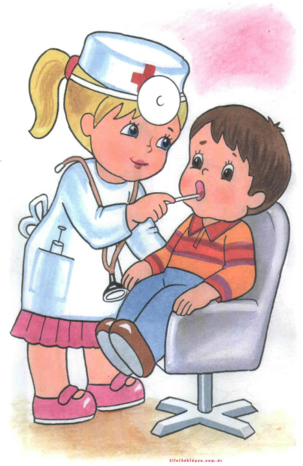
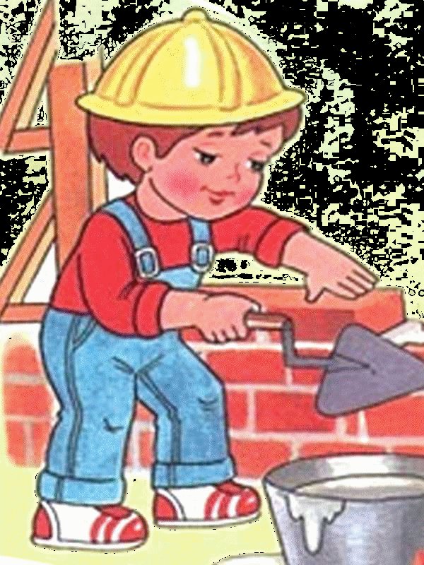
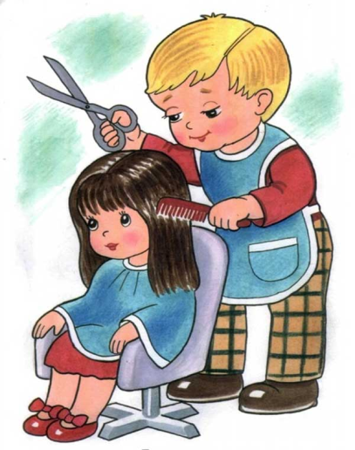
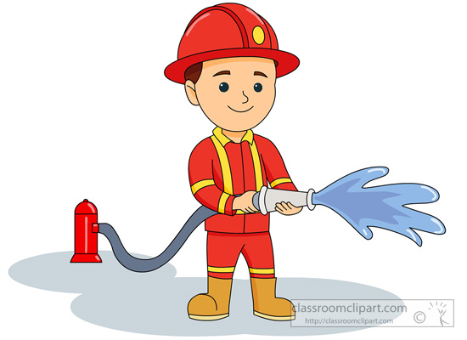

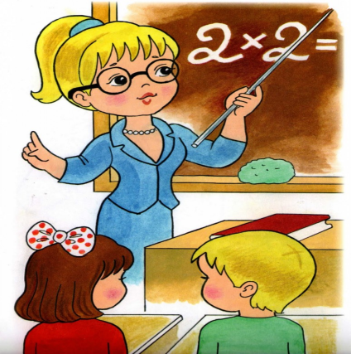
ALL PROFESSIONS ARE IMPORTANT, ALL PROFESSIONS ARE NECESSARY! Штанская Полина Сергеевна МОУ ДО «Центр дополнительного образования детей «Росток» г. Электросталь 2018 год

Slide 2

A DOCTOR
The doctor in a white cap, with a suitcase in his hand will check your neck,
measure the pulse,
put a hot water bottle and a compress,
give some vitamins to reduce stress!

Slide 3

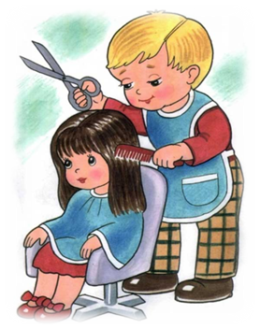
A HAIRDRESSER
Give me scissors and a comb,
I’ll do your hair.
A hairdresser certainly
will look you stylish.

Slide 4
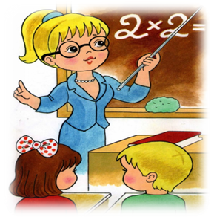
A TEACHER
The bell sounds cheerful
in yellow-red September,
noisy kids
open the doors of the school.
Our teacher leads us to the country of knowledge.

Slide 5

A SELLER
We go to the store
to choose the right purchase,
The seller will help us to make the right choice.

Slide 6
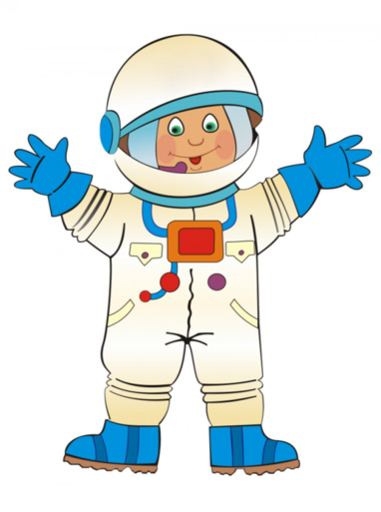
A COSMONAUT
The cosmonaut, of course,
is strong, intelligent and skillful.
Space is not a joke.
The work is difficult and he has no fun.

Slide 7
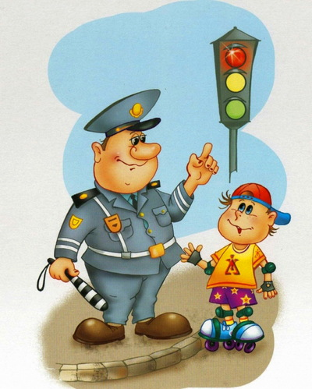
A POLICEMAN
If you're in trouble,
Dial number 02.
The police will come to you,
And, of course, will help you.

Slide 8
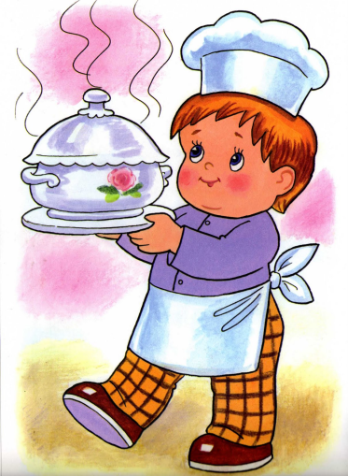
A COOK
Take some things:
poultry meat, dried fruits, rice, potatoes...
A cook can make some tasty food.

Slide 9
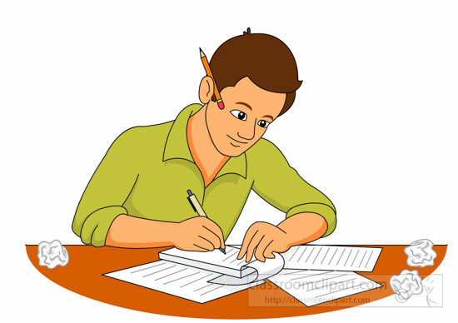
A WRITER
A writer is a gentle nature,
He is very sensitive!
Let the Muse come every day
at breakfast and dinner time,
everyone will understand,
how much we need him!
He will deserve a lot of medals
for his works.

Slide 10
A BUILDER
He will build a lot of things:
a skyscraper and a stadium.
a kindergarten and a hospital.
Even the house where my family lives
is made by a builder!

Slide 11
A FIREFIGHTER
A firefighter is a profession that needs reward,
You are true heroes,
People respect you!

Slide 12
A PILOT
The pilot knows his business well,
he flies a plane or an airplane.

Slide 13
THANK YOU FOR YOUR ATTENTION

