Slide 1
Урок английского языка 3 класс
«Моё любимое место»

Slide 2
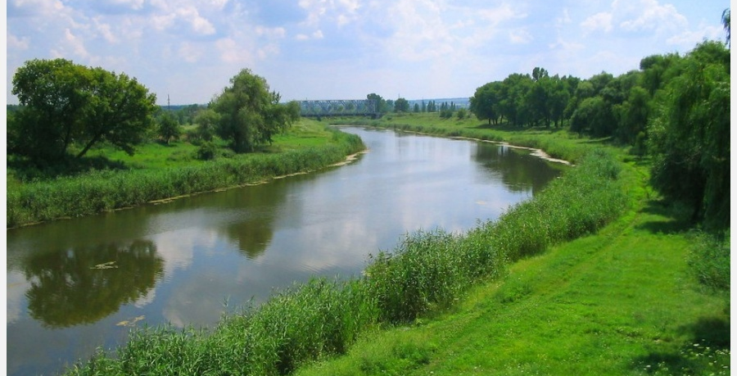
a river

Slide 3
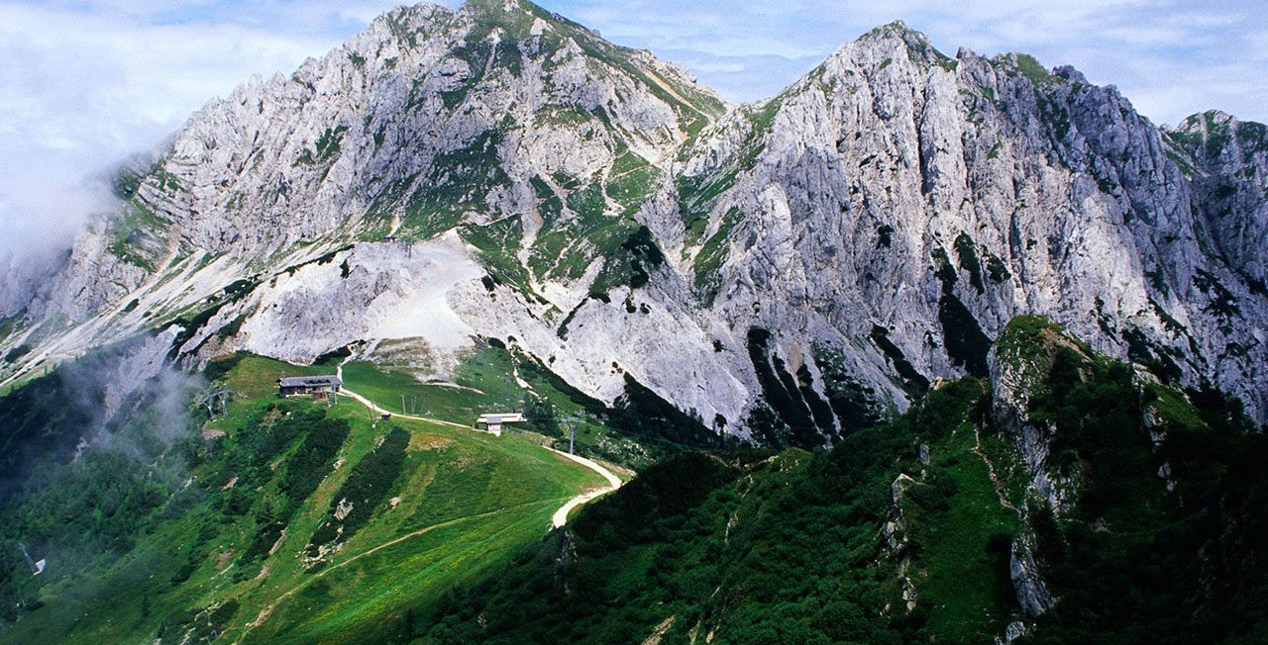
mountains

Slide 4
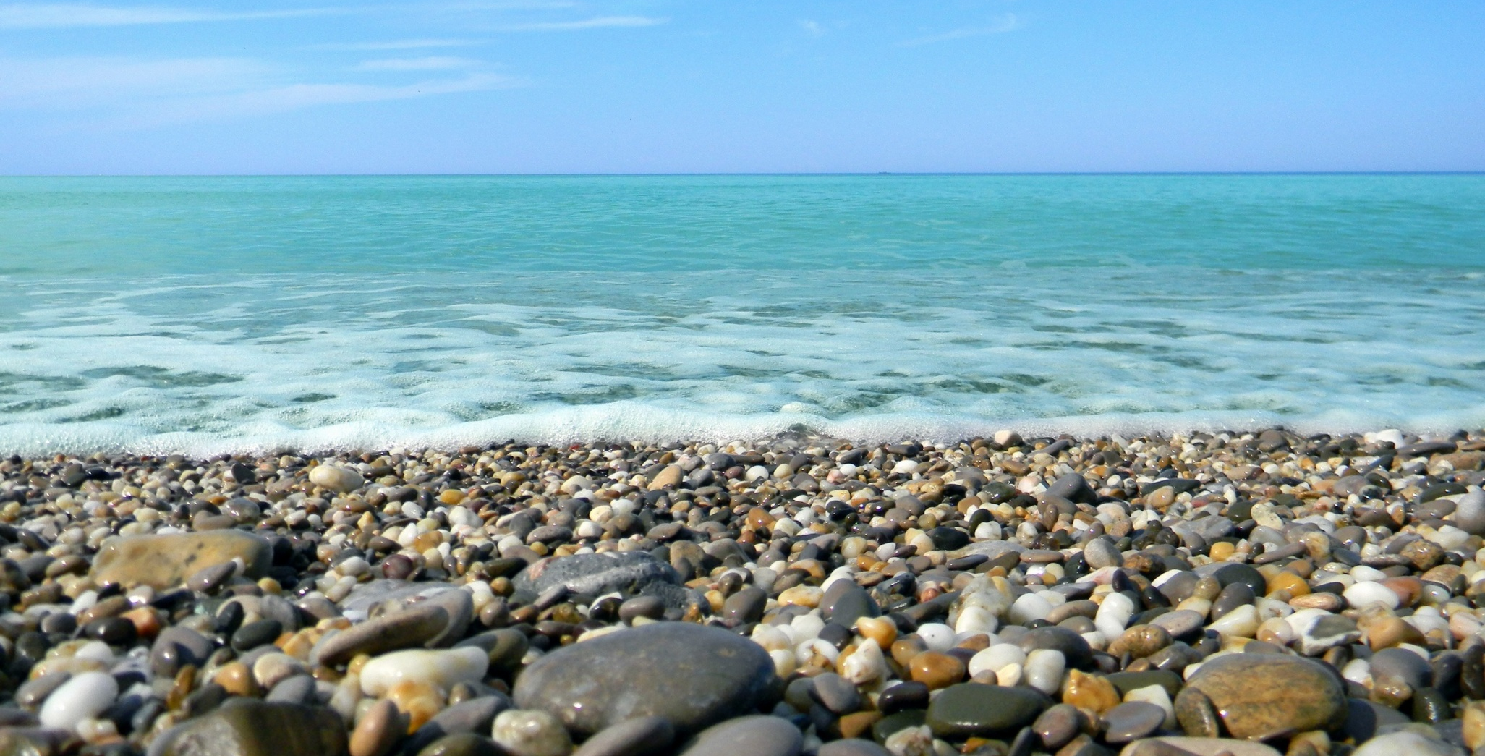
a sea

Slide 5
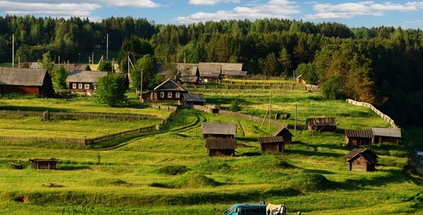
a village

Slide 6
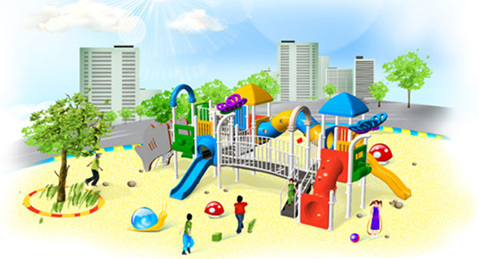
playground

Slide 7
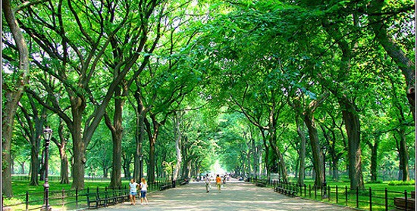
park

Slide 8
The theme of our lesson is
«My favourite place»

Slide 9
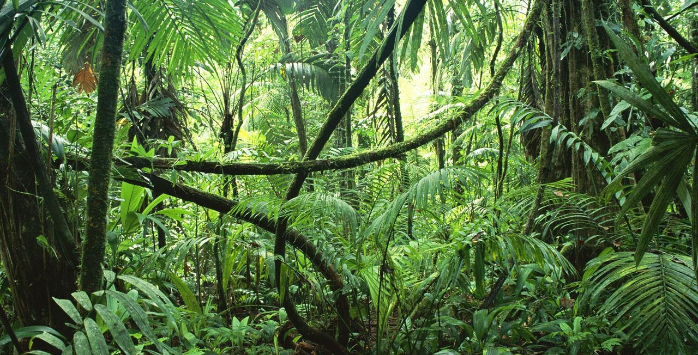
rainforest

Slide 10
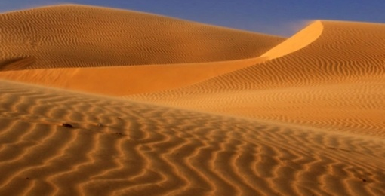
desert

Slide 11
The tasks of our lesson are
-to revise the words
-to practise using there is/are
-to summarise

Slide 12
Sing a song
This is my favourite place
It’s where I like to be.
This is my favourite place
There’s a river and the sea.
This is my favourite place
There are flowers and a tree
This is my favourite place
It’s where I like to be.
I’m happy here, I’m happy here,
I’m very, very happy

Slide 13
sentences
There is a river in this place.
There are lots of trees.
There are two parrots in the trees.
There is a chair on the beach.
There are three fish in the river.
There are two frogs.
There are lots of flowers.

Slide 14
The words to help you
Sea: boats, beach, lots of water
Rainforest: tall trees, flowers
Village: small houses, goats, sheep, horses

Slide 15
The end

