Slide 1
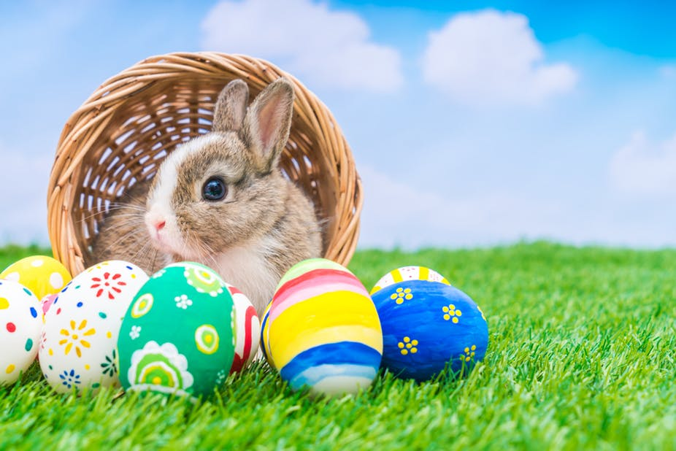
EASTER

Slide 2
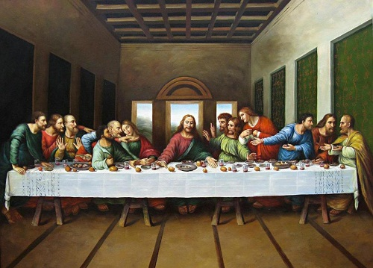
Maundy Thursday

Slide 3
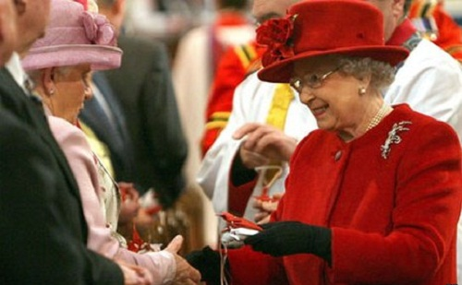
Royal Maundy

Slide 4
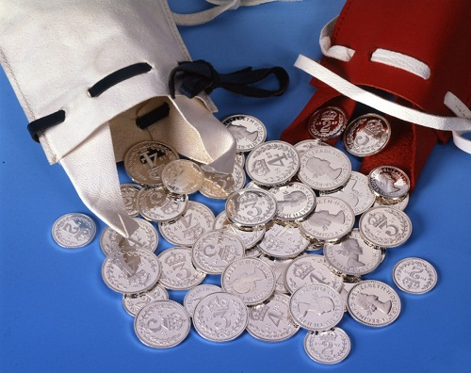
Maundy Money

Slide 5


Slide 6

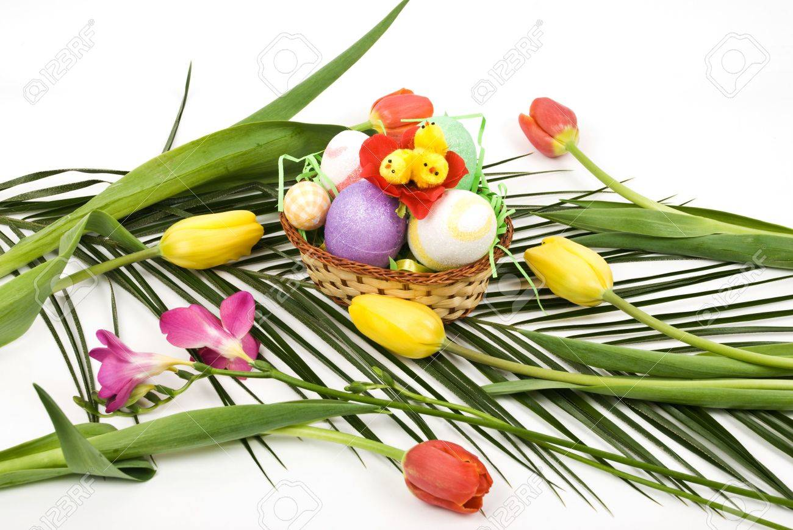
Easter Symbols
Cross
Palms

Slide 7
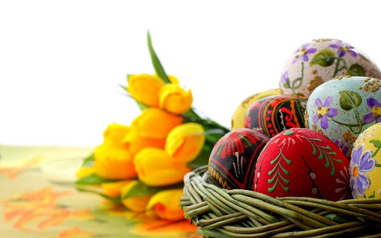
Easter eggs

Slide 8
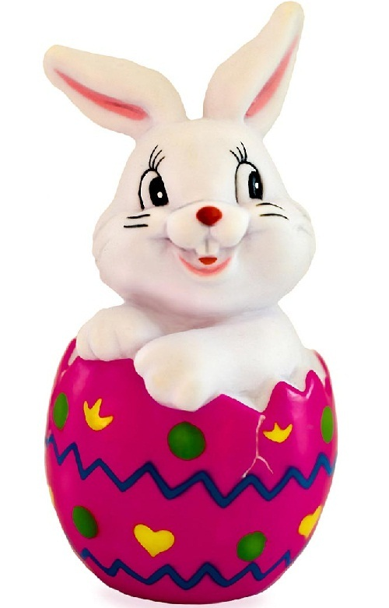
Easter Bunny

Slide 9
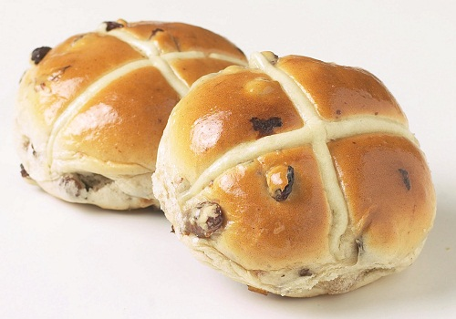
Hot Cross Buns

Slide 10
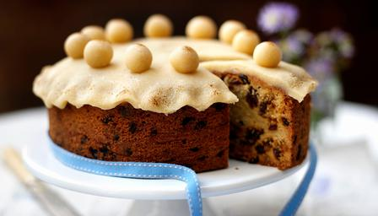
Simnel Cake

Slide 11
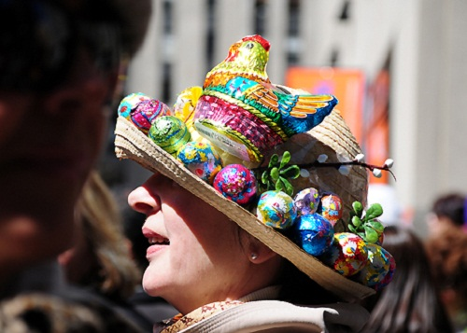
Dressing Up For Easter

Slide 12
