Slide 1

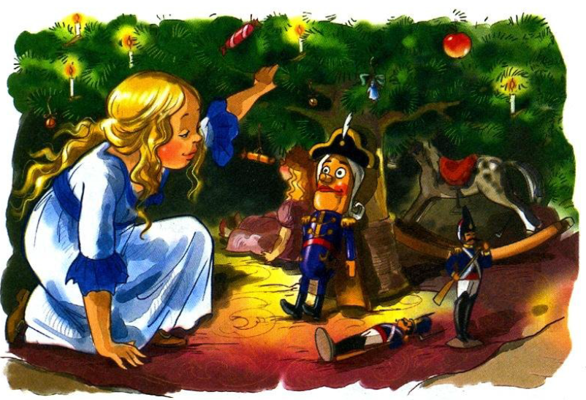
English reading

Slide 2


Chapter one
1. Help Marie and Fritz trim the tree. Find the words which connect with Christmas. Translate them into Russia.

Slide 3

2. Put the sentences in the right order and read them aloud.
Suddenly Fritz breaks the nutcracker's jaws.
Drosselmeyer brings many presents to the children.
Marie cries and puts the toy in a the box near her bed.
The girl sees once more present under the Christmas tree.
Drosselmeyer shows how to crack nuts with the nutcracker's

Slide 4
3.Who said these words
1. This is a nutcracker Marie.
2. Good night my dear, nutcracker.
3. If you choose this toy you must love and take care of it.
4. Do you know my little reader, what Christmas Eve is?

Slide 5
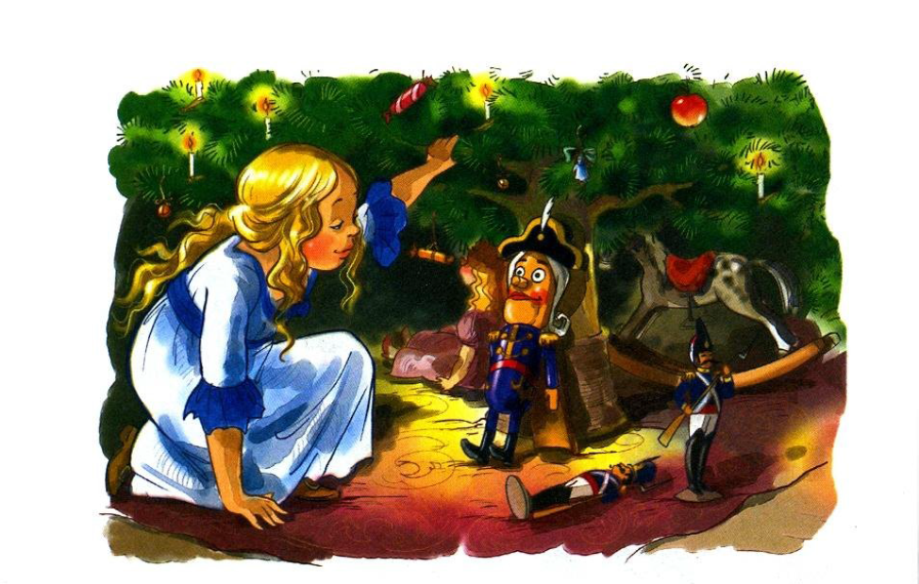
4.Match the pictures with the sentences from the text.

Slide 6
Read the text again and decide whether the following statements are true or false.
And, of course, it is time when all boys and girls sleep till midnight and wait for presents.
Uncle Drosselmeyer is an inventor and clockmaker.
Fritz and Marie are not happy and merry.
Marie cries she likes the nutcrackers very much.
It is not very late and the parents tell their children to go to the bed.

