Slide 1
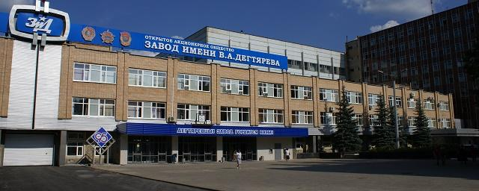
Degtyarev Plant.
Yesterday-Today-Tomorrow.
Done by Maria Sycheva
Dmitry Ukhin.
Form 8-b,gymnasium 1.
Teacher: N.L.Savelyeva.
Kovrov, 2017.

Slide 2
The plan:
The history of the plant.
The main production of the plant.
Famous people of the plant.
The youth of the plant.
The centenary of Degtyarev plant.

Slide 3
The Purpose of the Project
To show the value of the plant, features of its development in the industrial sphere and in the social sphere.

Slide 4

The Centennial History of the Plant.
In 2016 the Open Joint-Stock Company “Degtyarev plant” celebrated its centenary.
The general director of the plant is Alexander Vladimirovich Tmenov.

Slide 5
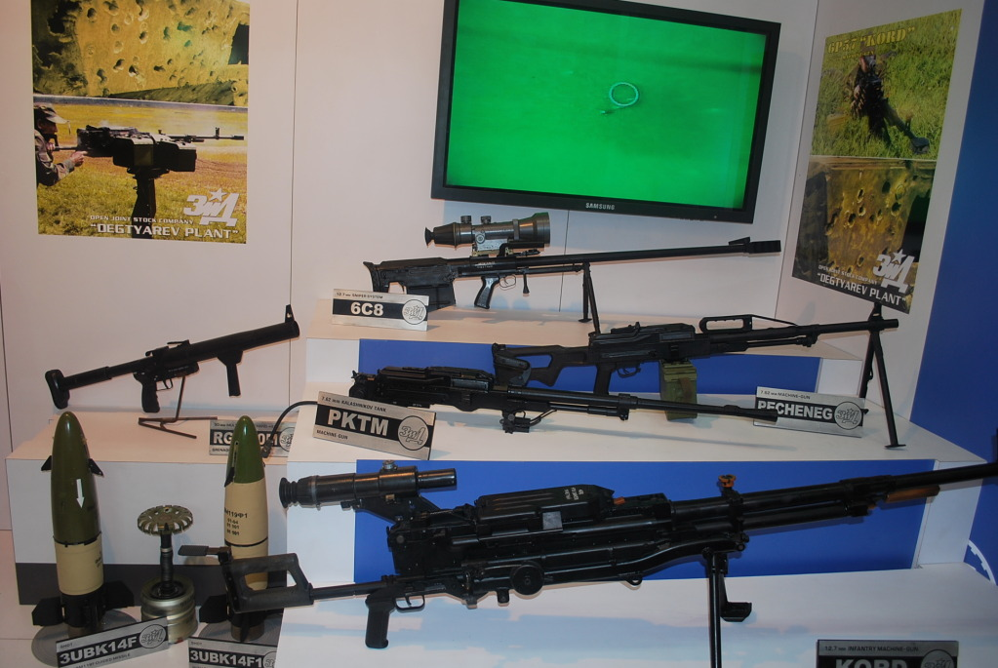
The Centennial History of the Plant
The history of the plant began in the years of the World War I, when the Russian army experienced an acute shortage of automatic weapons. On August 27, 1916, the construction of the first buildings of Kovrov plant began. The manufacture of automatic weapons has always been the main business.

Slide 6
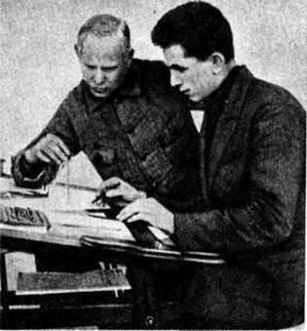
The Founders of the Plant.
V.G.Fedorov and V.A.Degtyarev were the founders of the plant.
V. A. Degtyarev and V. G. Fedorov

Slide 7
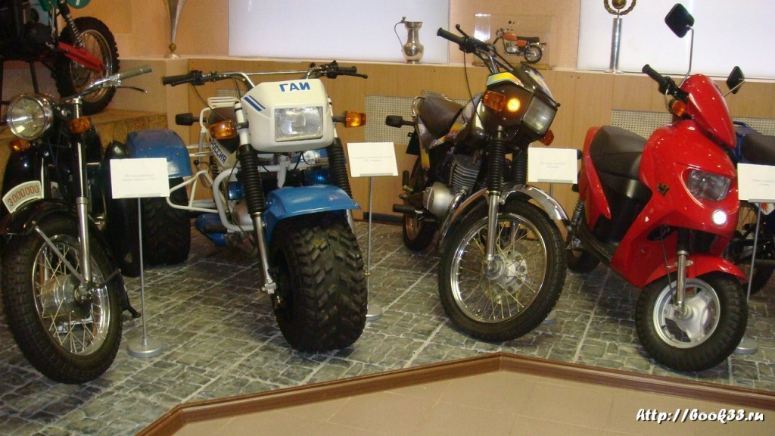
The Production of Motorcycles.
In 1946 the plant mastered the production and release of motorcycles. A lot of models were exported to foreign countries.

Slide 8

The Main Production of the Plant.
In 1959 the plant began the production of missile weapons, anti-tank guided radioactive shells and missiles "Bumble Bee", "Malyutka", "Fagot” “Factoria” and portable anti-aircraft complexes “Strela” and “Igla”.

Slide 9
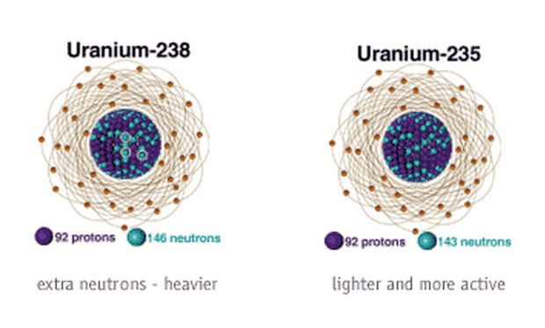
In 1959 the equipment for the separation of isotopes of uranium was produced at the plant.

Slide 10

Famous people.
A lot of wonderful people worked at the plant, those who contributed immensely to the development of the enterprise, the development of special-purpose products, strengthening the defense capability of the country. The most respected and honorable veterans of the plant were awarded medals.

Slide 11
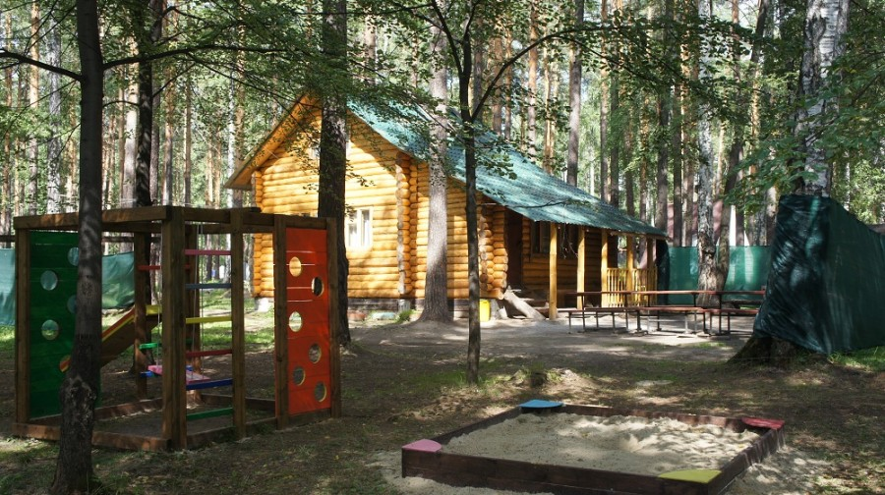
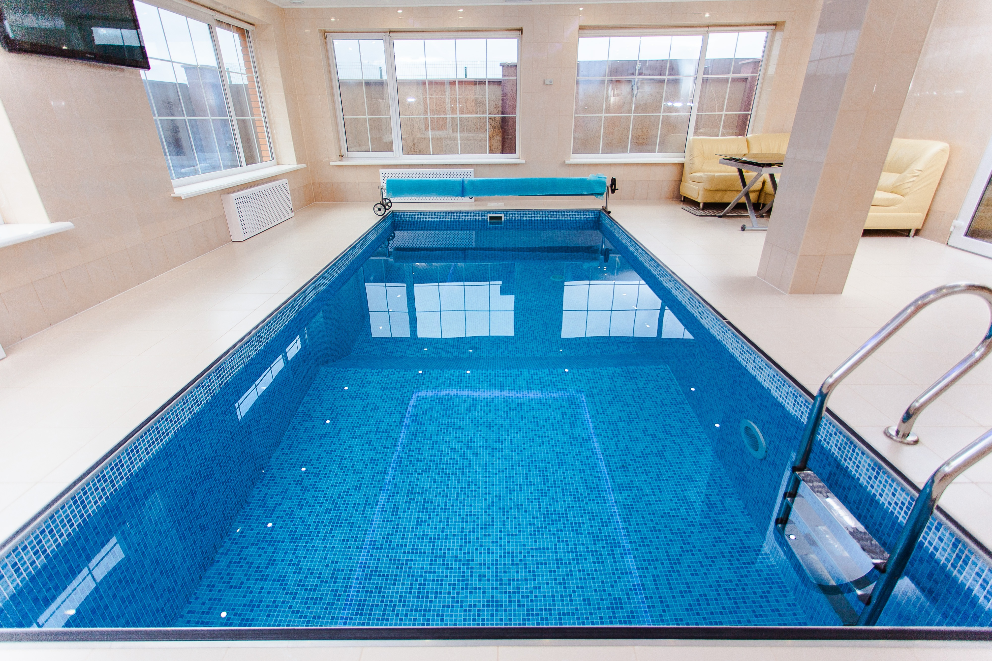
Care for Veterans.
There is a sanatorium for the people who work at the plant.
Notes:
К юбилейным датам ветеранам выплачивают премии, они так же продолжают отдыхать на базе отдыха «Суханиха», для них организуют и проводят различные мероприятия и концерты в доме культуры им. В.А. Дегтярева

Slide 12

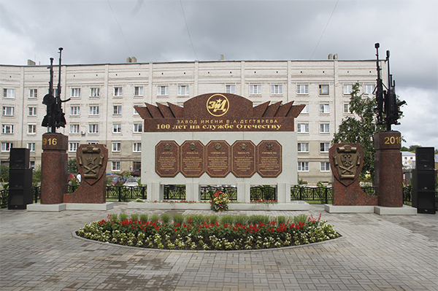
The awards of the Plant.

Slide 13
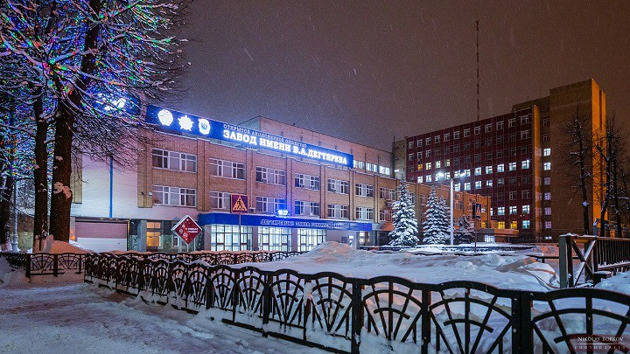
The youth of the plant.
The enterprise pays great attention to the development of the youth. There is a Council of Young Professionals. It is headed by Anna Sokolova
Notes:
В каждом подразделении есть ответственные за работу с молодежью, СМС помогает молодым кадрам быстрее адаптироваться, включая их в общественную жизнь предприятия.

Slide 14
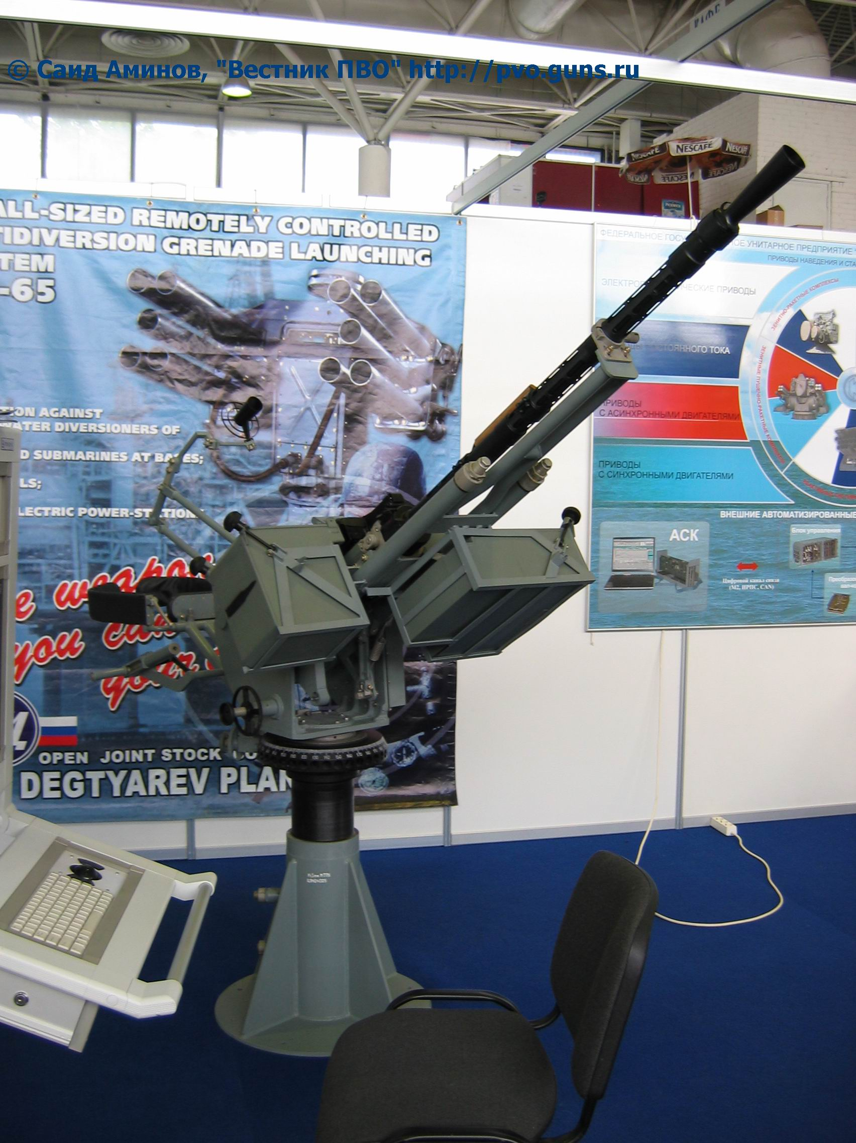
Confidence in the Future.
Nowadays Degtyarev plant is the modern multi-profile enterprise,the largest in Vladimir region. Many Kovrovers work at the plant.

Slide 15
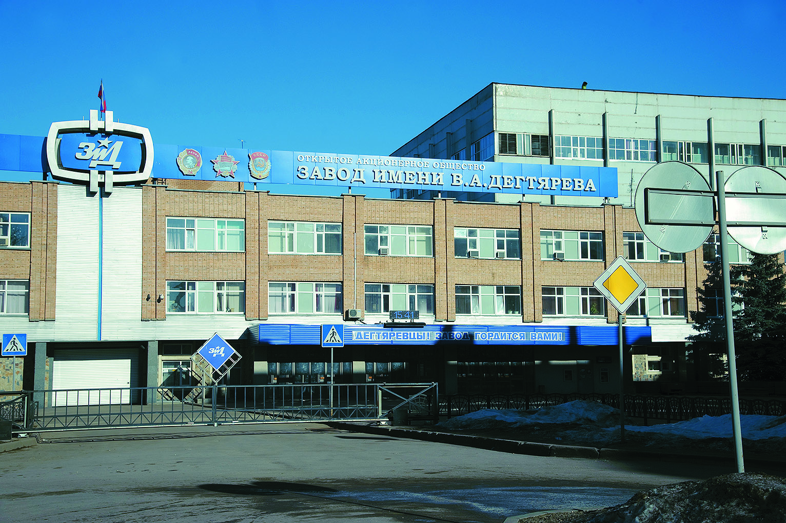
Thanks for your attention!

