Slide 1

Презентация к уроку английского языка в 3 Г классе
Тема: Времена года
Учитель :Шелудякова Дина Вячеславовна

Slide 2
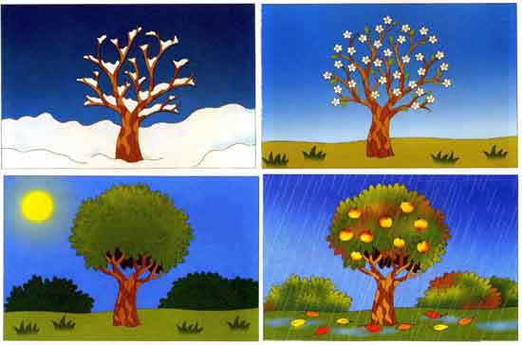
SEASONS

Slide 3
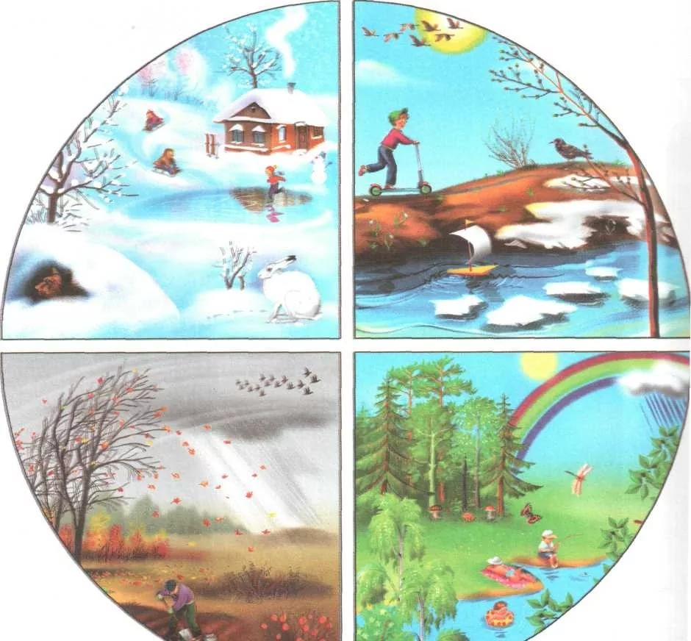
What season is it now?
What’s the weather like today

Slide 4
Spring is green.
Summer is bright.
Autumn is yellow .
Winter is white.

Slide 5
Seasons.

Slide 6
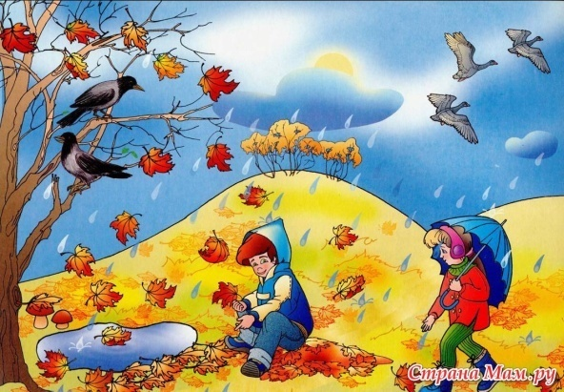
PSRNIG
UMERMS
ATUNMU
ITERWN

Slide 7

SPRING
SUMMER
AUTUMN
WINTER

Slide 8
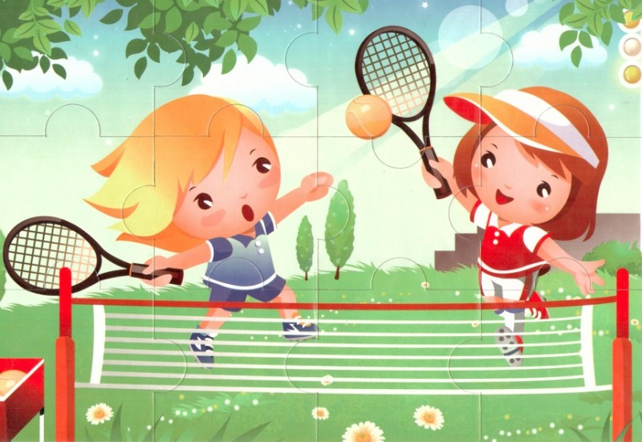
Time and Seasons\01 - No. 72,

Slide 9
QUestions
How many seasons are in the year ? Which ?
When is it cold?
When is it warm?
When is it hot ?
What season is it now ?

Slide 10
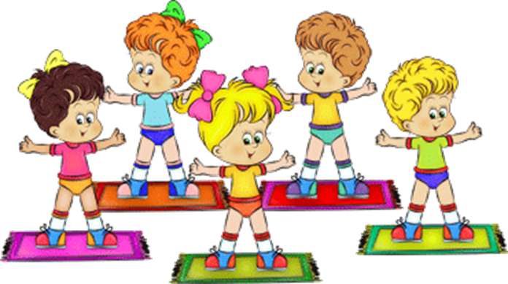
Warm- Up

Slide 11
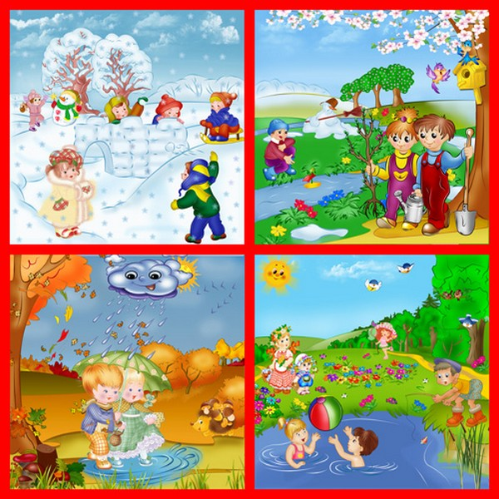
The Months of the Year

Slide 12
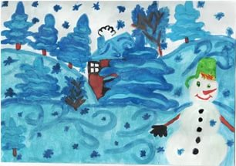
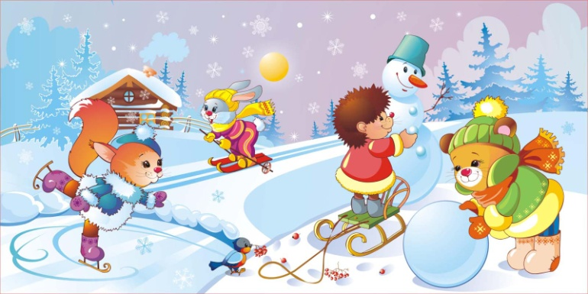
WINTER
DECEMBER |disɛmbə|
JANUARY |dʒanjʊ(ə)ri|
FEBRUARY |fɛbrʊəri|

Slide 13
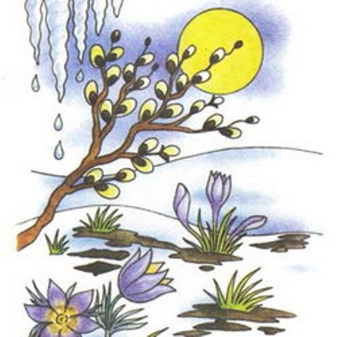
SPRING
MARCH |mɑ:tʃ|
APRIL |eɪpr(ɪ)l|
MAY |meɪ|

Slide 14

Summer
JUNE |dʒu:n|
JULY |dʒu:laɪ|
AUGUST |ɔ:ɡʌst|

Slide 15
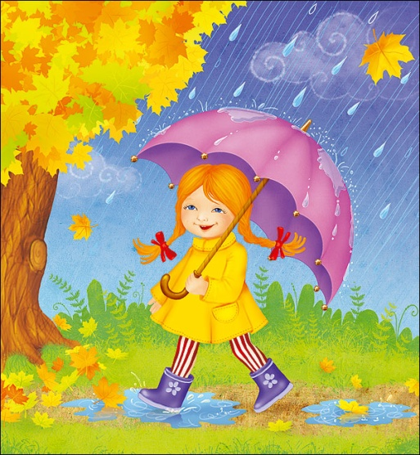
AUTUMN
SEPTEMBER |sɛptɛmbə| OCTOBER |ɒktəʊbə| NOVEMBER |nə(ʊ)vɛmbə|

Slide 16
My favourite month is… My favourite months are…

Slide 17
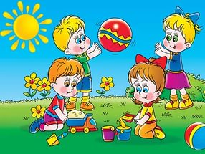
Let’s Play

Slide 18
It is spring now. March, April and May are spring months. The weather is fine. It is warm . You can see beautiful flowers.
It is summer. June, July and August are summer months. It is hot and sunny in summer. The weather is nice. The days are long and the nights are short. Children run and play in the streets.
It is autumn. September, October and November are autumn months. The weather is rainy and windy. The trees are yellow and red. There are many fruits and vegetables.
It is winter. December, January and February are winter months. The weather is cold in winter. It usually snows. The streets are white. The days are short and the nights are long. Children play snowballs in the streets.

Slide 19
Let’s Play

Slide 20
A spring day feeds a year.
Rain at seven, fine at eleven.
After rain comes fair weather.

Slide 21
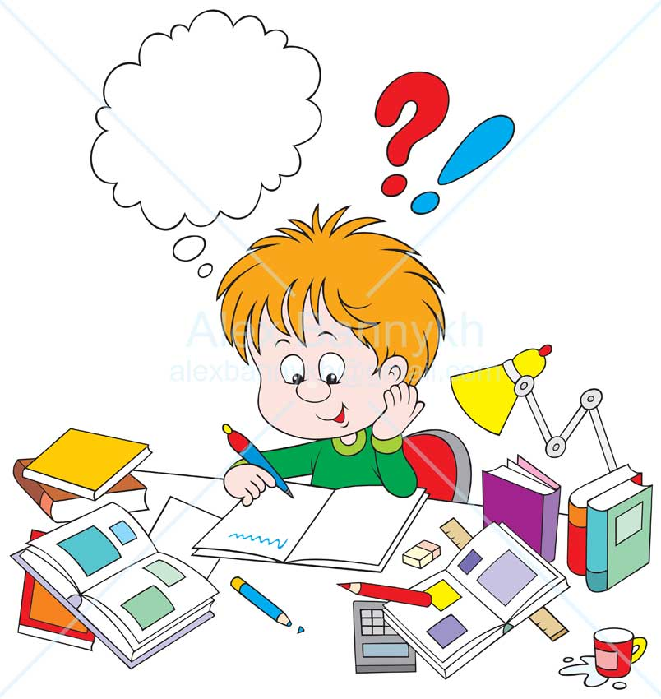
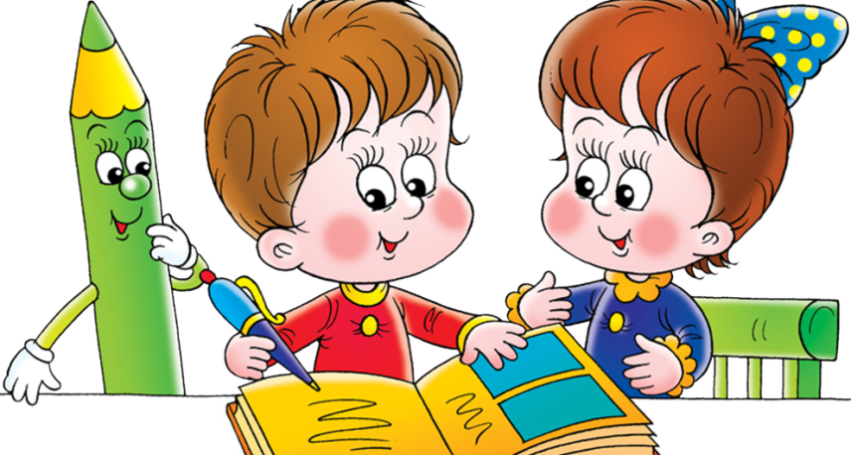
Homework
1) Учебник: с 36 у 8а , с 41 у 7а месяца в словарь с переводом .
2) Учебник : с 35 у 7а читать и переводить
3) Нарисовать времена года и подписать название месяцев и погоду.

Slide 22

Well done !!!

