Slide 1
Japan attractions
Presented by Vorontsova Anastasia

Slide 2
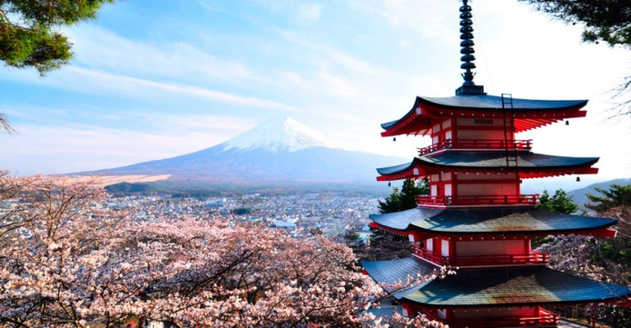
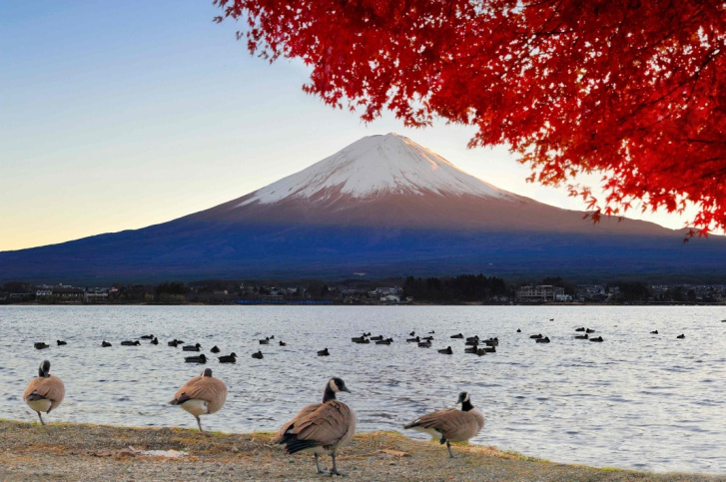
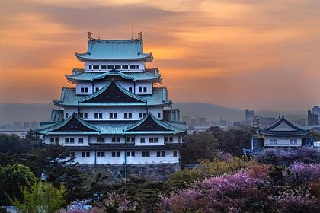
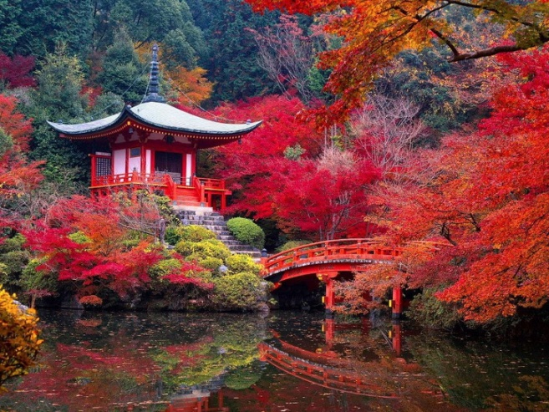
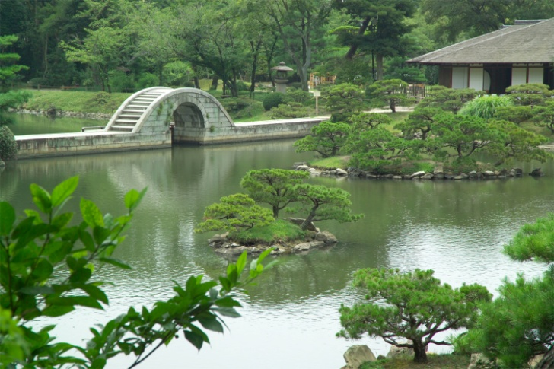
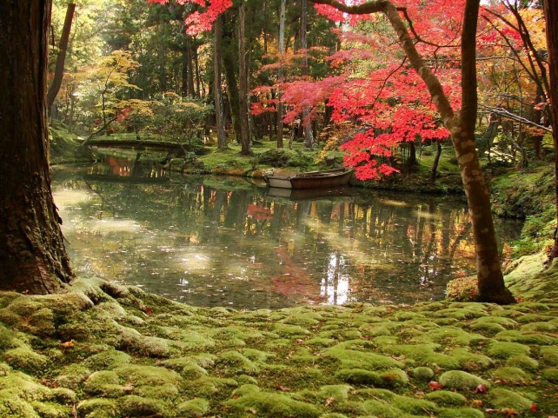
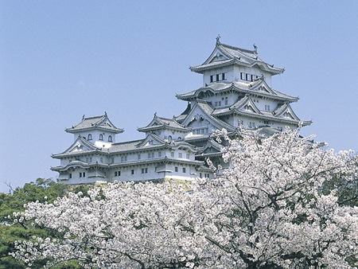
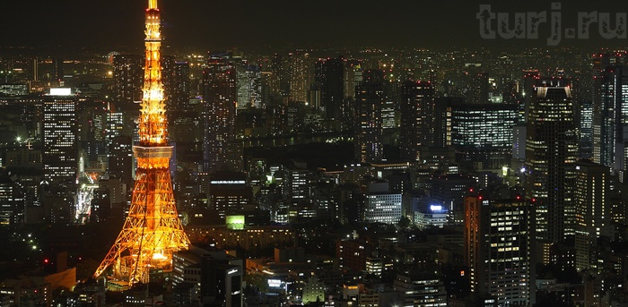
Japan is one of the most popular tourist places. Here you can see unique combination of traditional temples and modern buildings. The fabulous beauty of Japan can be seen at any time of the year.

Slide 3
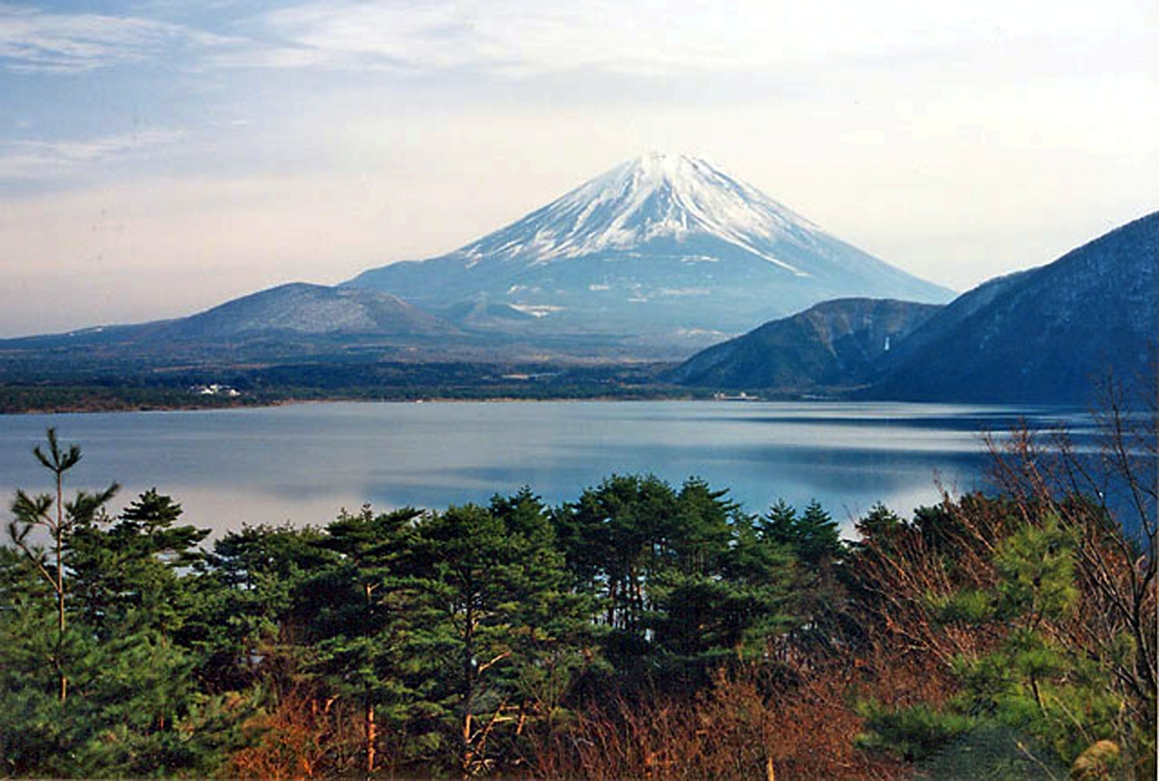

Mount Fuji
Mount Fuji or Fujiyama is one of the main Japanese sights. Not only tourists dream to climb to its top, locals want it too. It’s because mount Fuji in Japan is considered holy and every citizen at least once in their lives must stand on its top.

Slide 4
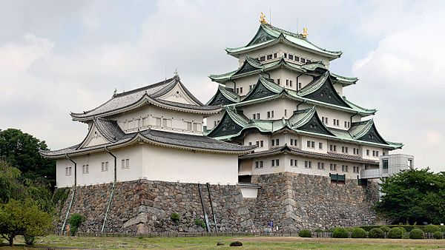
Nagoya castle
During the Edo period (1603-1868), Nagoya Castle was the heart of one of the most important castle towns in Japan, Nagoya-juki, which was a post station on the Minoji road. But in 1945 aviation of the USA practically wiped out the Castle. It rebuilt due to donations from ordinary people.

Slide 5
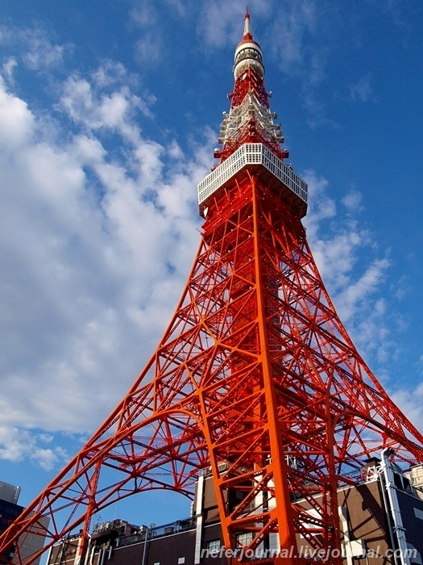
Tokyo Tower
One of the main symbols of Japanese capital is famous Tokyo Tower, that’s externally like the Eiffel Tower. Its height is about 333 metres. Over 150 million people have visited the tower. FootTown, a four-story building directly under the tower, houses museums, restaurants and shops. Departing from there, guests can visit two observation decks. The two-story Main Observatory is at 150 metres, while the smaller Special Observatory reaches a height of 249.6 metres.

Slide 6

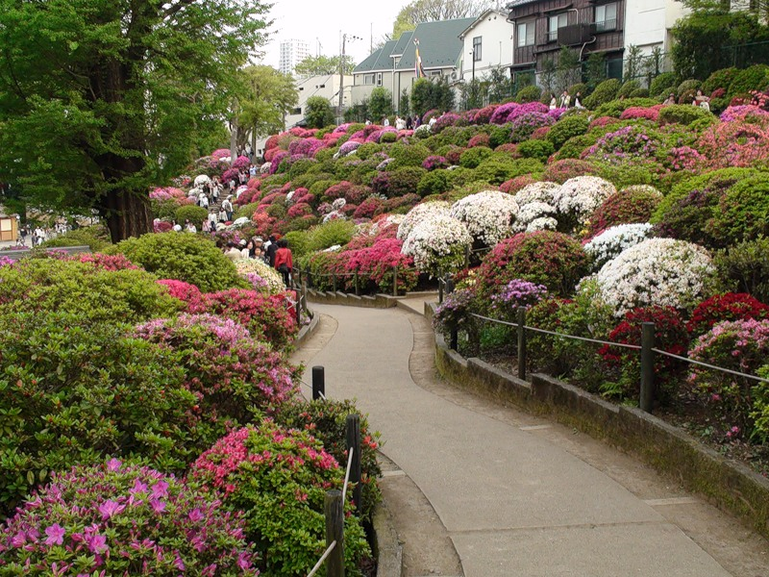
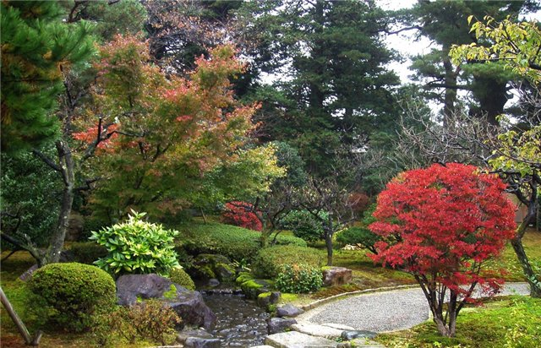
Garden Happoen
Tokyo is famous for its amazing gardens, that’s strewn with sakura flowers. But this park stands out other. On Russian it translates “Garden of 8 landscapes”. It’s because the garden is really beautiful from every side. And in Japanese tradition number 8 symbolizes happiness. Every visitor will feel calm and feeling of happiness.

Slide 7
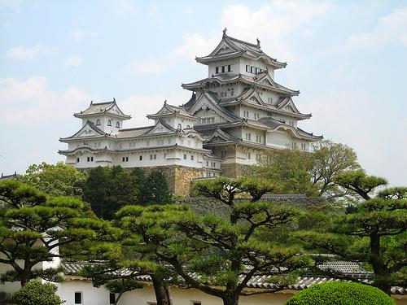
Castle of the White Heron (Himeji Castle)
This perfect castle was founded in 1333 and from that time until the 17th century experienced a permanent reconstructions. This castle is exquisite and majestic at the same time, one of the oldest and most colorful attractions in Japan. No wonder that in 1993 it was included in the UNESCO World Heritage List.

Slide 8


Saiho-ji Temple
The temple, which is famed for its moss garden, is commonly referred to as "Koke-dera" (苔寺), meaning "moss temple“. Primarily the temple constructed to honor Amitabha (celestial buddha). Over time, the temple fell into disrepair, and in 1339, the chief priest of the nearby church called the famous Japanese gardener to help him revive Saihō-ji as a Zen temple. Saihō-ji was destroyed by fire during the Ōnin War, and twice ravaged by floods during the Edo Period, but has since been rebuilt. The area around the pond is covered with more than 120 varieties of moss.

Slide 9
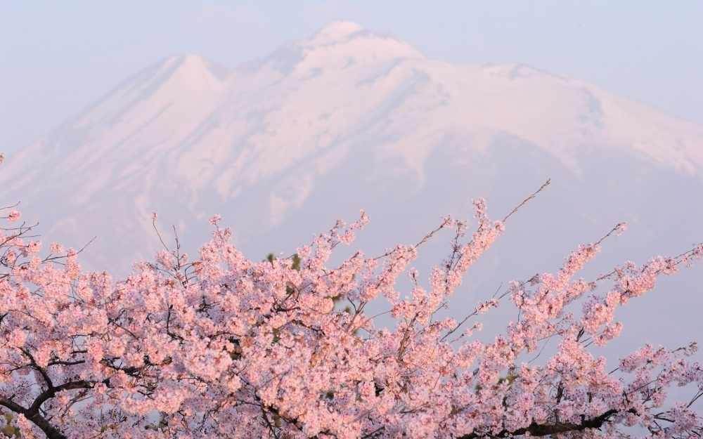
Thanks for watching!

