Slide 1
My favourite season

Slide 2

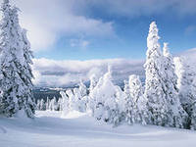
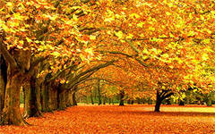

summer
winter
autumn
spring

Slide 3
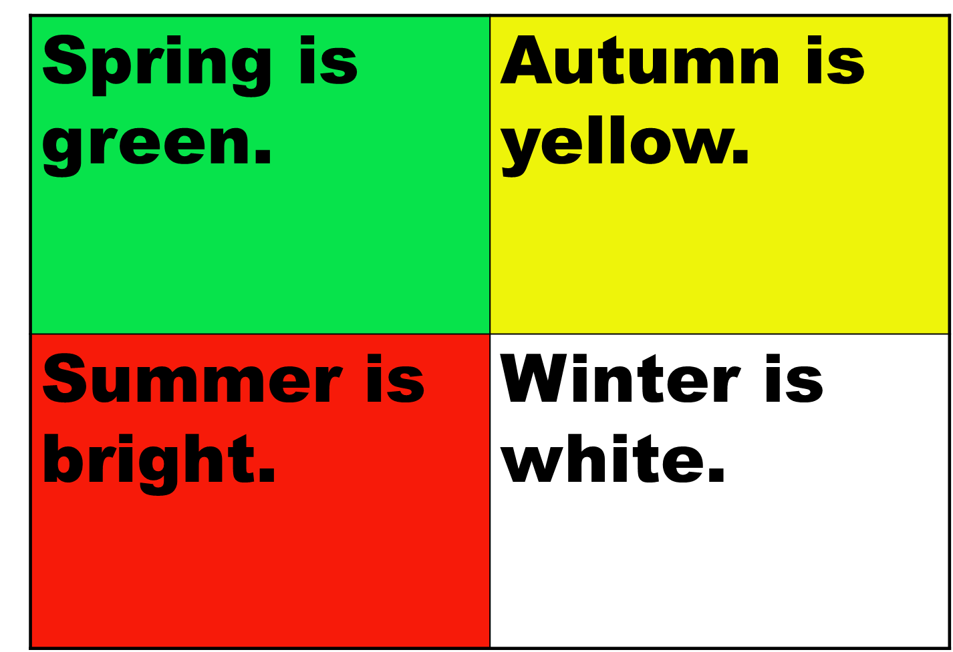

Slide 4
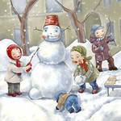
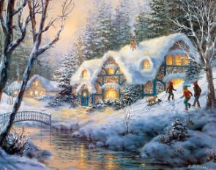
December
January
winter
February

Slide 5
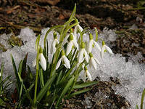
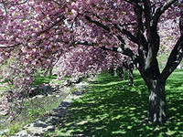
March
spring
April
May

Slide 6
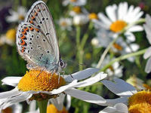

June
summer
July
August

Slide 7
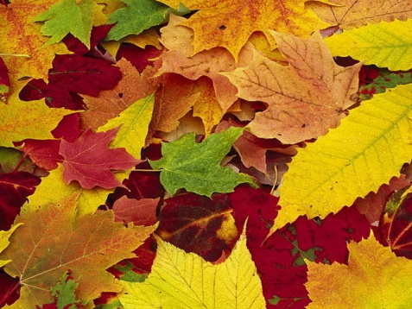

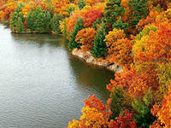
September
autumn
October
November

Slide 8
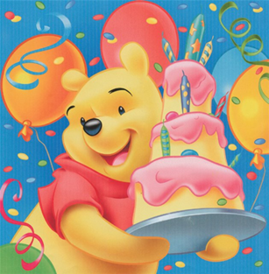

Questions:
1.When is your birthday?
My birthday is in …

Slide 9


2. What is your favourite season? (Spring, Summer, Winter, Autumn)
My favourite season is …….

