Slide 1
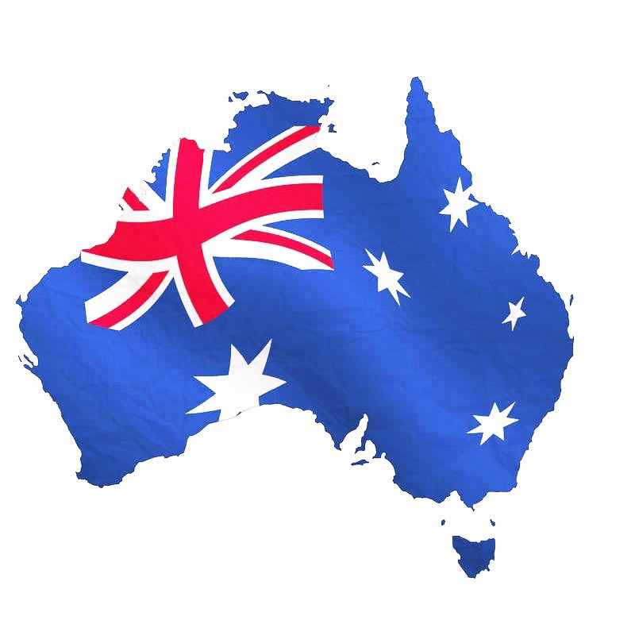
BUSINESS CULTURE AND CUSTOMS IN AUSTRALIA
Made by
Zaychenko
Marina Alexandrovna

Slide 2

Welcome to Australia
This is the flag of Australia.

Slide 3

It is a coat of arms of Australia.

Slide 4
These are some of the business customs and culture aspects of Australian life that will help you understand Australian people and integrate into their society.

Slide 5
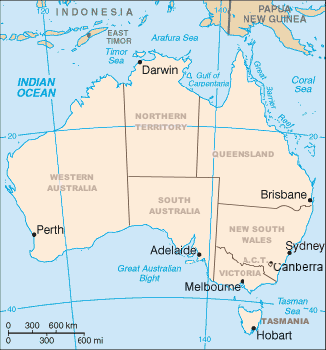
Australia is a federation of six states, together with ten federal territories. The Australian mainland consists of five of the six federated states and three of the federal territories (the "internal" territories). The state of Tasmania is an island about 200 km (120 miles) south of the mainland.

Slide 6
Facts and Statistics
The official name of Australia is
Commonwealth of Australia
Location: Oceania, continent between the Indian Ocean and the South Pacific Ocean
Capital: Canberra, the largest city is Sydney
Climate: Generally arid to semiarid; temperate in south and east; tropical in north
Population: 22,507,617 (July 2014 est.)
Ethnic Make-up: Caucasian 92%, Asian 7%, aboriginal and other 1%

Slide 7
Government: democratic, federal-state system recognizing the British monarch as sovereign
Business language: English
Business hours: 8.30am or 9.30am to 4.30pm to 5.30pm,
Monday to Friday.

Slide 8


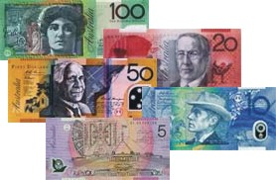
TheAustralian currency
Australia was the first country in the world to have a complete system of bank notes based on plastic.
Australia’s currency consists of coins of 5,10,20,and 50 cent and 1 and 2 dollar denomination;
and notes of 5,10,20,50 and 100 dollar denomination.

Slide 9
Business Mentality
Australians are very straightforward when it comes to business, so they do not need to build relationships for a long time before doing business with you. They are receptive to new ideas.
But if you manage to impress them, they will not make it obvious.

Slide 10
Australians demonstrate modesty as much as they appreciate it. They can even downplay their own success, so do not jump into conclusions straight away.
They appreciate modesty, so try not to oversell your company and do not even think of applying aggressive sales techniques. Try to be factual, friendly and to the point, avoiding self-importance.

Slide 11
If you find yourself challenged to a controversial discussion during a meeting, do not worry - it is nothing personal. They find debates entertaining and will initiate them by making provocative statements, to which it is best to respond with humour!

Slide 12
Negotiating and Decision Making
Australians get down to business quickly with a minimum amount of small talk.
They are quite direct and expect the same in return. They appreciate brevity and are not impressed by too much detail.
Decision-making is concentrated at the top of the company, although decisions are made after consultation with subordinates, which can make decision making slow and protracted.

Slide 13
Do not try to rush the decision - patience is very much appreciated.
The good news is that Australians do not find it hard to say "no", so the answer will be clear and straightforward.
They do not like high-pressure techniques.
Negotiations proceed quickly. Bargaining is not customary. They will expect your initial proposal to have only a small margin for negotiation.

Slide 14
Gender equality
Female expats looking to do business in Australia will find little or no gender bias. Australia is very progressive in terms of gender equality in the workplace, with many top-level positions being filled by women.

Slide 15
Greetings
Australians are not very formal, so greetings are casual and relaxed – a handshake and a smile are appropriate.
However, while an Australian may say, ‘G’day’ or ‘G’day, mate’, this may sound patronising from a foreigner. Visitors should simply say the traditional ‘Hello’ or ‘Hello, how are you?’As to titles of courtesy, they prefer to use first names, even at the initial meeting.

Slide 16
Communication
Do not be surprised to hear colleagues talking bluntly and frankly to one another – try to remember that in Australia, direct communication is valued far more highly than diplomacy. A good general rule for business etiquette in Australia is to always try and 'get along' – the last thing one wants to be considered is a loner or a malcontent.

Slide 17
The Art of Conversation
Popular welcome topics include the weather, sports (particularly Australian Football AFL in Victoria, and National Rugby League NRL in New South Wales and Queensland). Anything related to Australia in a positive way is a good conversation starter.
Topics to avoid though are religion, politics and sex - unless the Australian counterpart brings it up. Do not get into immigration and aboriginal issues no matter how curious you are. Also, comments on accents will not be welcome, as they often distinguish social classes.

Slide 18
Business meetings
Regarding dress code, men should wear a dark coloured, conservative business suit.
Similarly, women should wear a smart dress or a business suit.
In Brisbane or other tropical areas, depending on the job function and company culture, men may wear shirts, ties and Bermuda shorts.

Slide 19
Business meetings in Australia should be scheduled a week in advance, and then confirmed a few days before they are due to take place.
Punctuality is important, it better to arrive a few minutes earlier. Be punctual, as lateness can be seen as a symptom of indifference.
Business meetings in Australia do not generally proceed from a set agenda – rather, they are viewed as open forums, in which ideas are to be debated and discussed. In fact, over-preparing for a meeting can make a person seem pushy – as though he wish to bully others into adopting an opinion on the issue at hand.

Slide 20
Dining Etiquette
Table manners are same as in Europe. Hold the fork in the left hand and the knife in the right while eating.
Indicate you have finished eating by laying your knife and fork parallel on your plate with the handles facing to the right.
Keep your elbows off the table and your hands above the table when eating.

Slide 21
The person making the invitation generally pays the bill in restaurants. However, it is usual for friends to split the bill.
If you are invited out for a drink, don’t recall the subject of business unless your counterpart does so.
In a pub, each person is expected to pay for a round of drinks which is called a “shout”. Avoiding your turn to pay will only create a bad impression of you.

Slide 22
Many invitations to an Aussies home will be for a 'barbie' (BBQ).
Guests to a barbeque typically bring wine or beer for their personal consumption. In some cases, very informal barbecues may suggest that you bring your own meat!
Arrive on time if invited to dinner; no more than 15 minutes late if invited to a barbeque or a large party.
Contact the hostess ahead of time to see if she would like you to bring a dish.
Offer to help the hostess with the preparation or clearing up after a meal is served.

Slide 23
Body Language
Strong eye-contact is essential - it demonstrates involvement.
The accepted distance between people at meetings is an arm's length.

Slide 24

Attitude to foreigners
Australia is a famously friendly, welcoming society – and foreigners should experience no xenophobia in the workplace . Remain friendly and open to colleagues and all will be fine.

Slide 25
Dos and don'ts of business in Australia
Do be honest and forthright – look to really get to know Australian colleagues on a personal level
Do get involved in “team-building”
Do make an effort to get to know colleagues outside of office hours
Don't try to prove credentials by talking about them – rather, show qualities by working hard
Don't be insulted if colleagues address someone in a blunt fashion – this is simply the way Australians communicate with one another

Slide 26

Thank you for attention!

