Slide 1
Guy Fawkes Day
Performed:
Student of class 8 «V»
«Lyceum №28
name of academician B.A.Korolev»
Mikheeva Ekaterina
Teacher:
Zemskova Natalia Alexandrovna
Nizhny Novgorod 2018

Slide 2
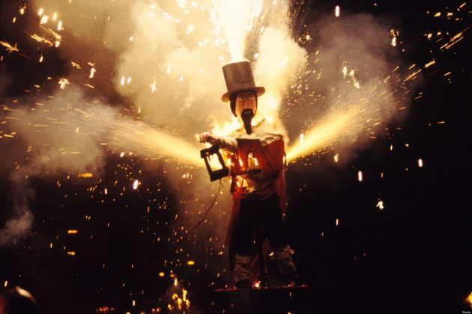
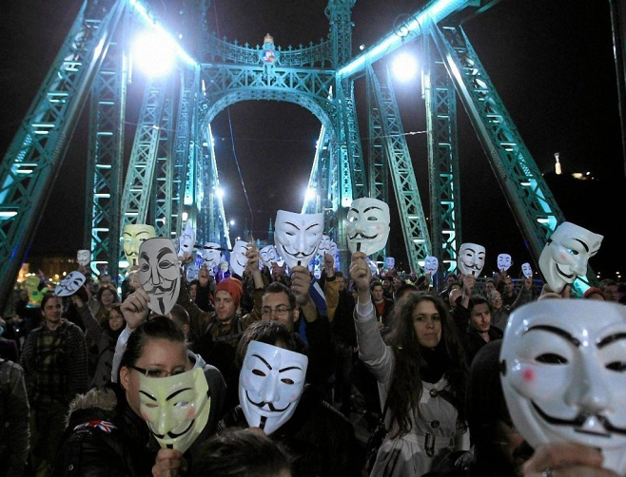
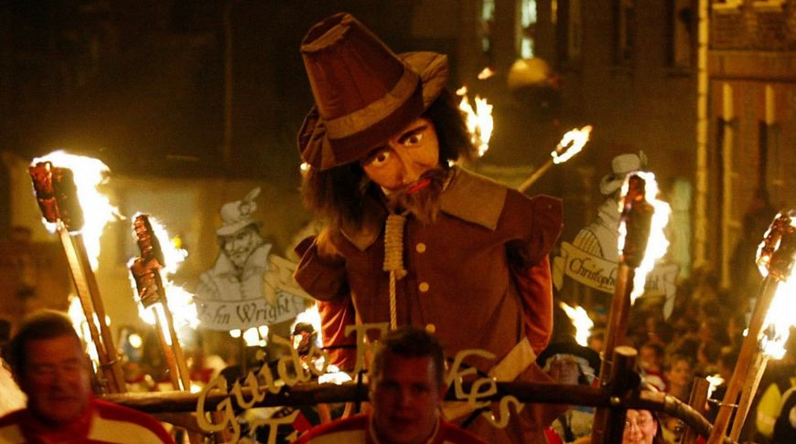
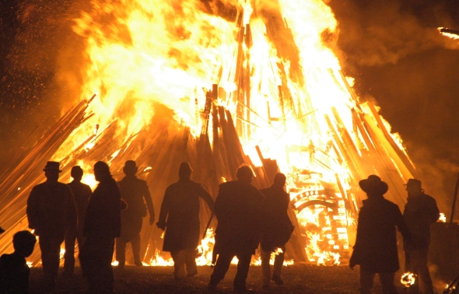
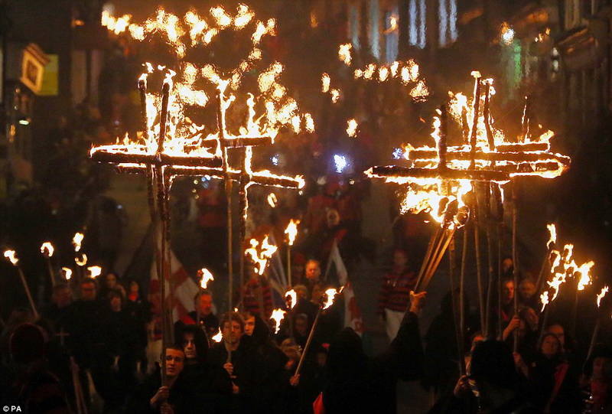
Guy Fawkes Day is celebrated in English speaking countries on the 5th of November.

Slide 3
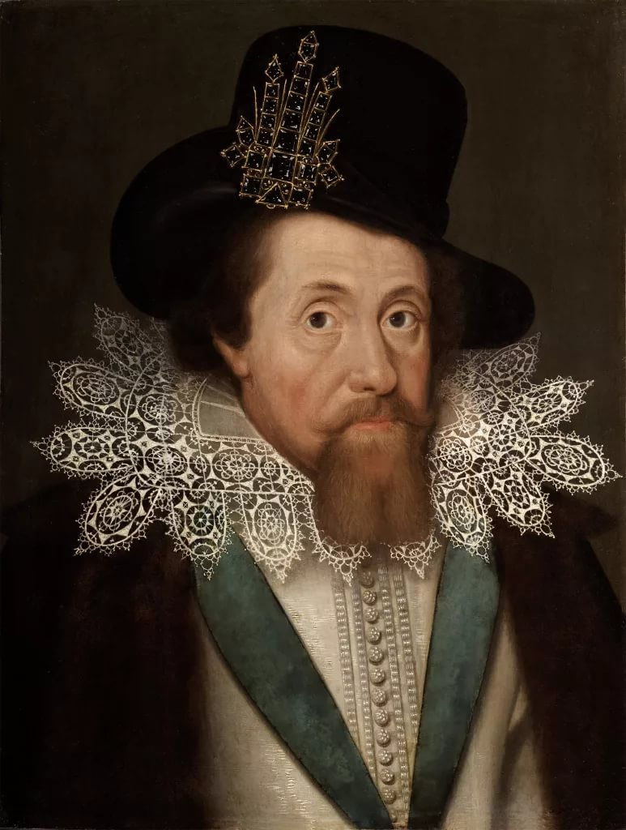
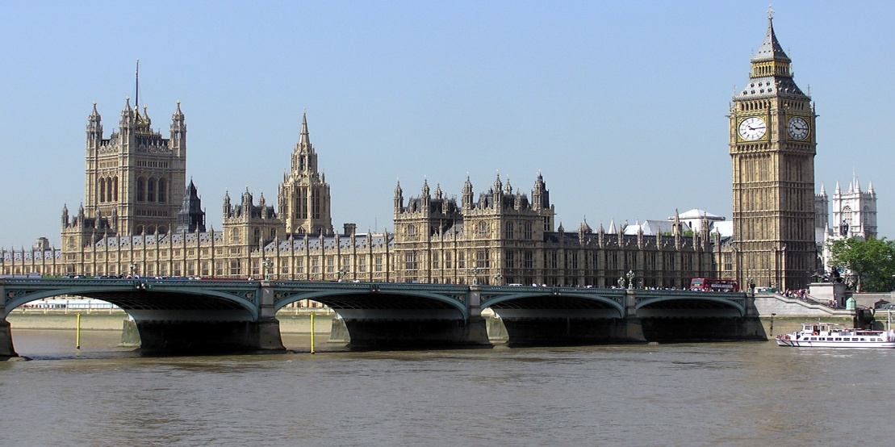
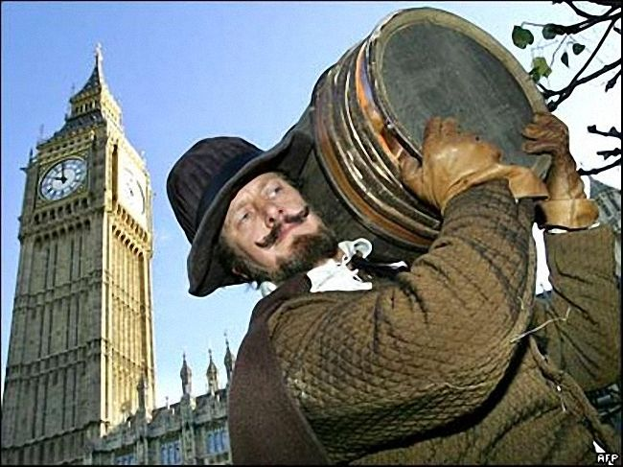
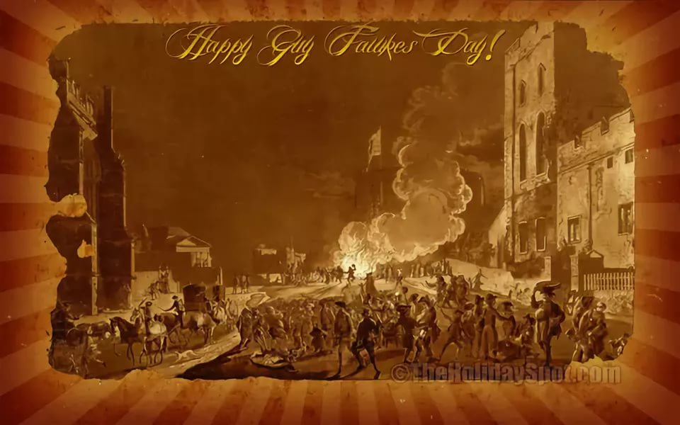
On that day in 1605 the King James I was to speak in front of the British Parliament.

Slide 4
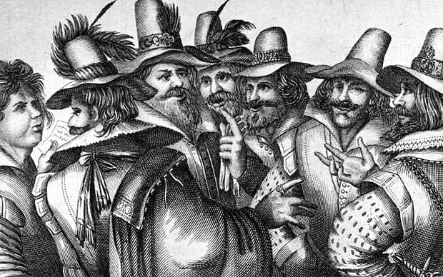
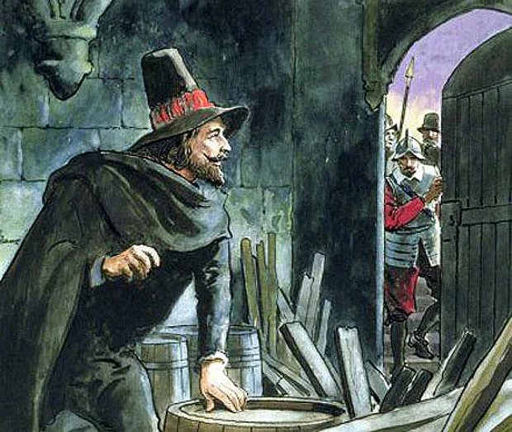
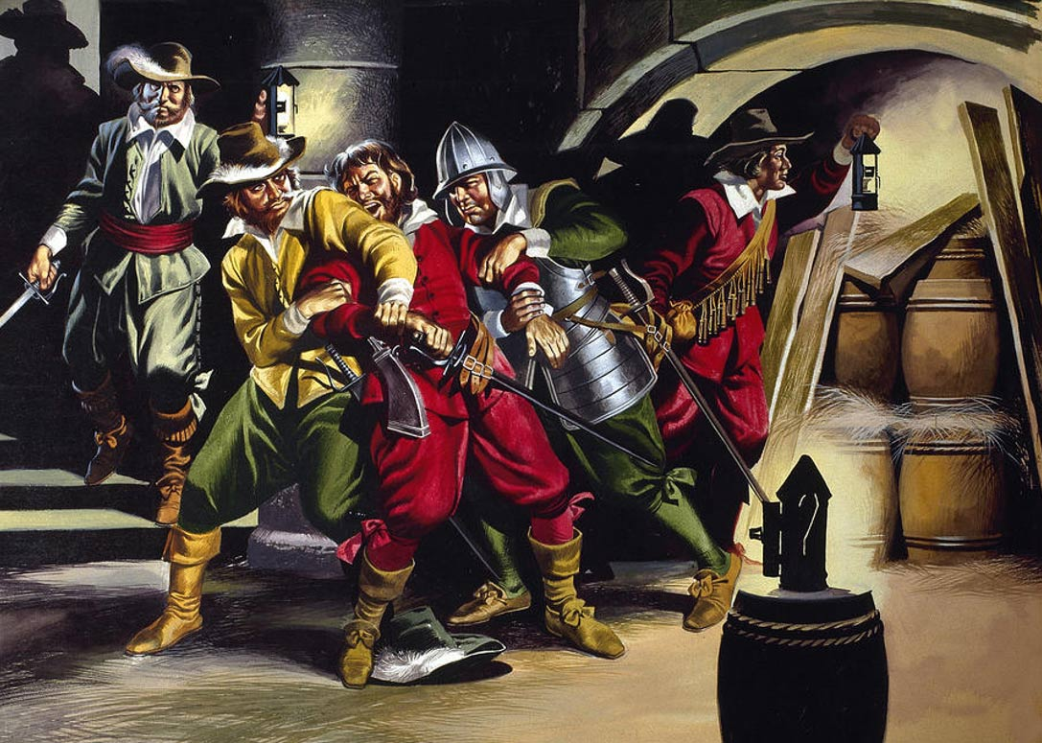
But there were some people, who decided to blow the House of Lords and hid 36 barrels of gunpowder under the House of Parliament and to kill the King and the Lords.

Slide 5
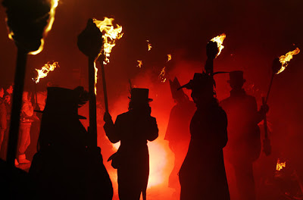
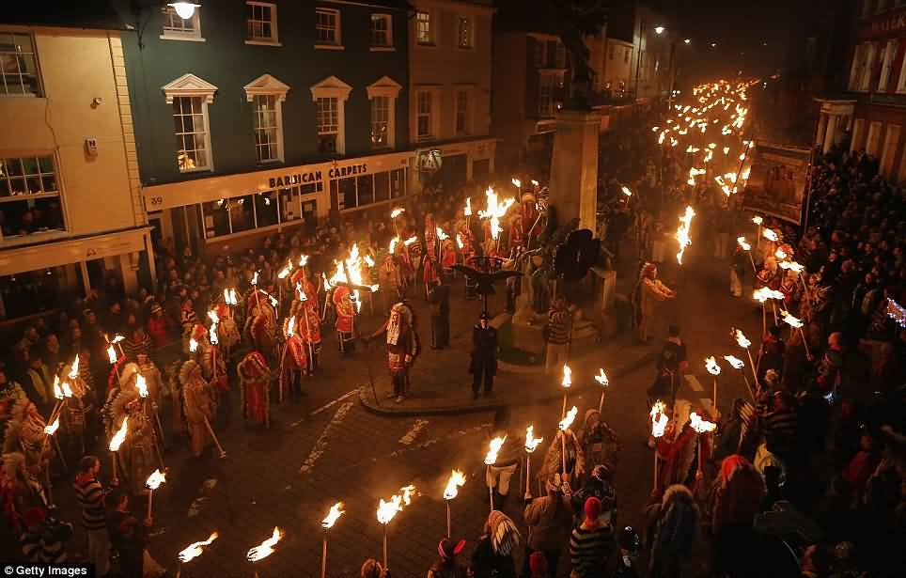
But it wasn’t going to happen. One of the conspirators decided to warn the Lord Montengro (one of his relatives) by writing him a letter. The King was informed and prepared a trap for the Catholics.

Slide 6
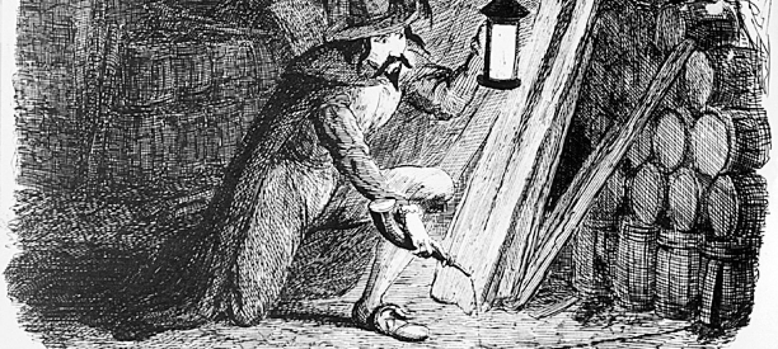
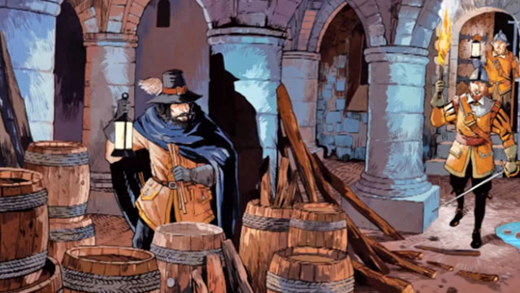
And when Guy Fawkes went to the basement to set the barrels of gunpowder on fire, he was taken red-handed.

Slide 7
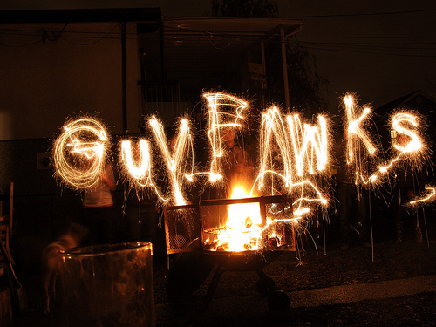
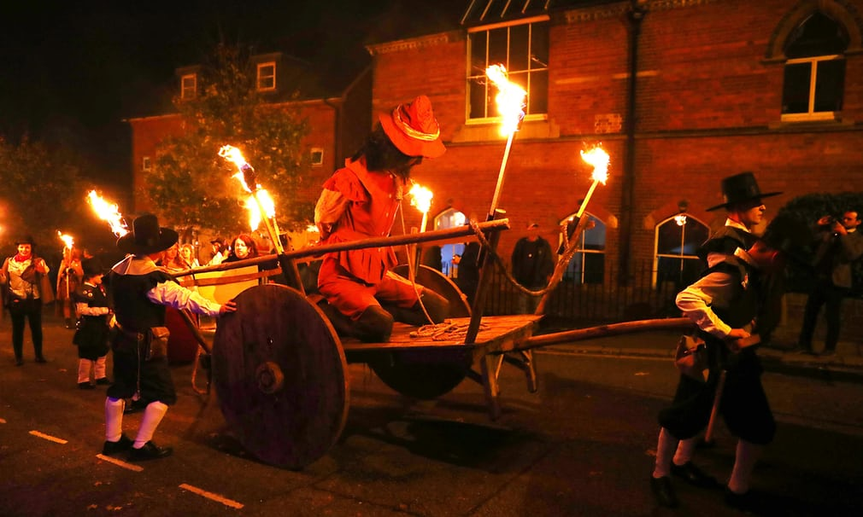
Under torture, he quickly «split» and called the names of all the conspirators.

Slide 8
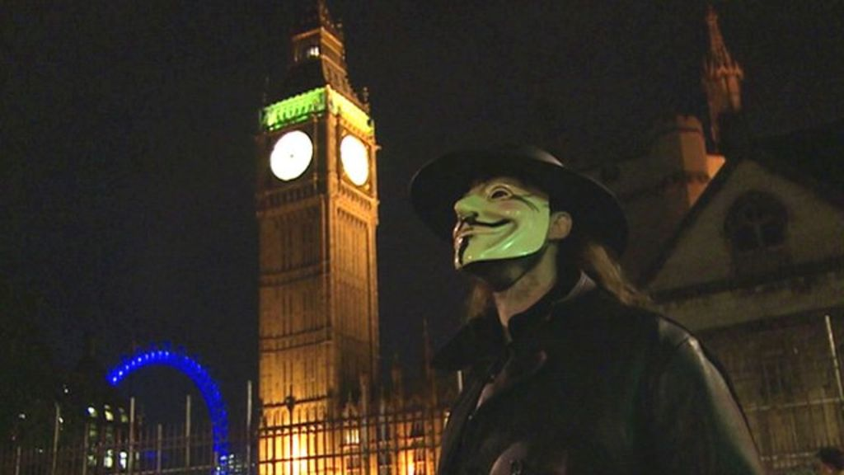
He was executed, but we know his name now because Guy Fawkes night is celebrated every year. This holiday is noisy and funny.

Slide 9
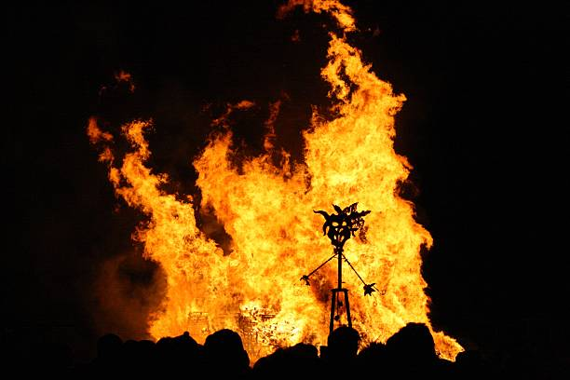
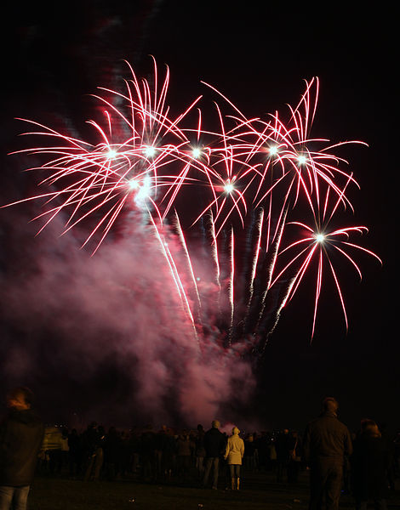
The day is full of lights, joy and bright fireworks. People go to the street in carnival costumes, hide their faces behind masks exploding firecrackers.

Slide 10
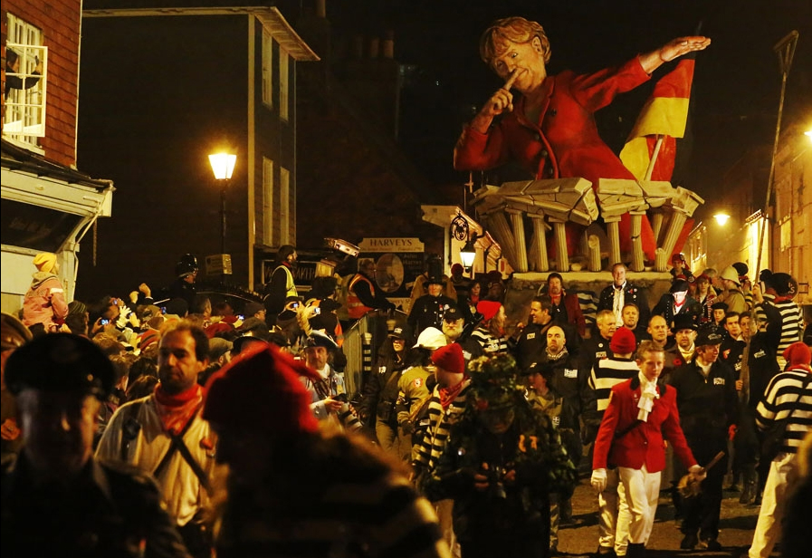
Interesting facts about this holiday.
1) Now before the meeting of Parliament is required to check all the cellars of the building
2)Some families bake cakes with a surprise, in which they add hot peppers.

Slide 11
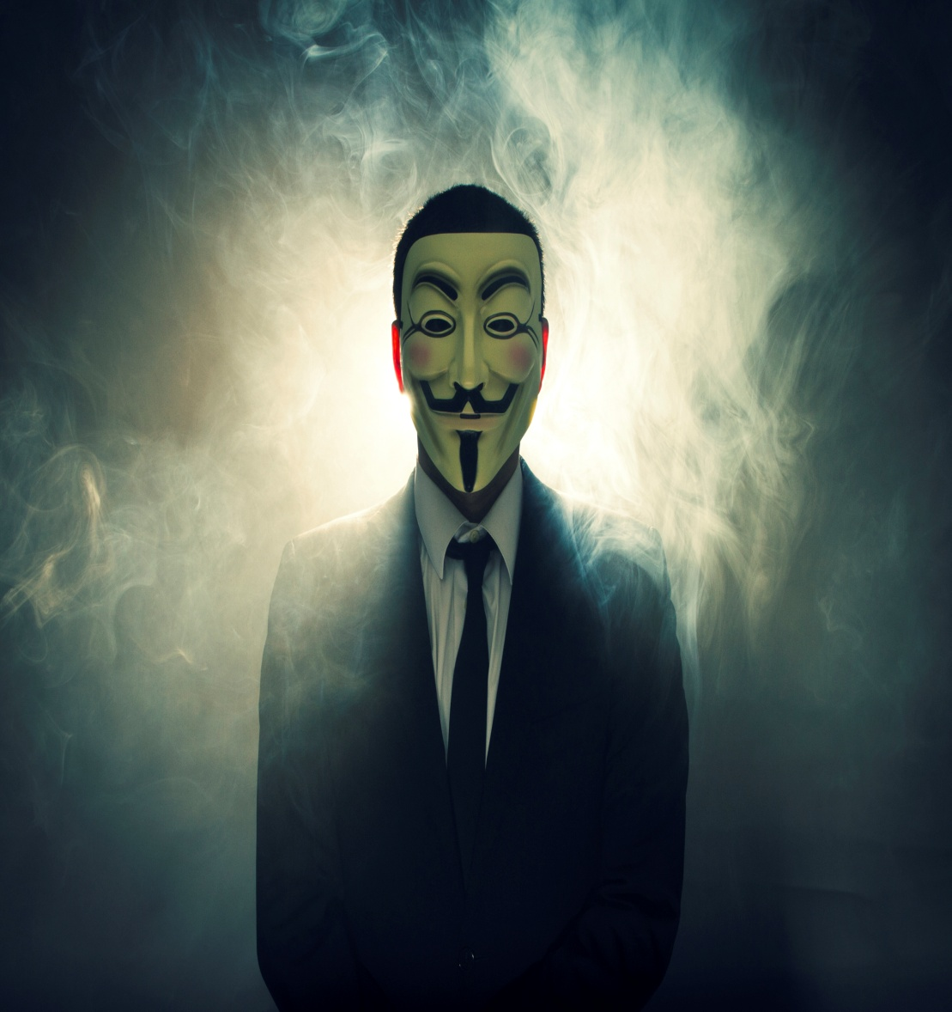
Most of you watched the film « V for Vendetta» Remember, remember The fifth of November…
The Guy Fawkes mask, created by David Lloyd, is known all over the world for its thin mustache and pointed goatee. It is the protagonist of the film "V for Vendetta".

Slide 12
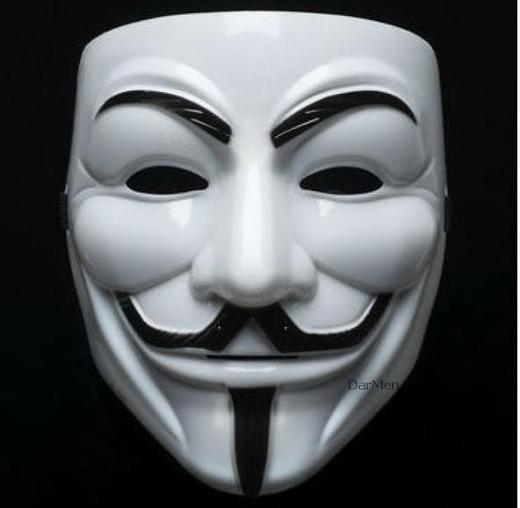
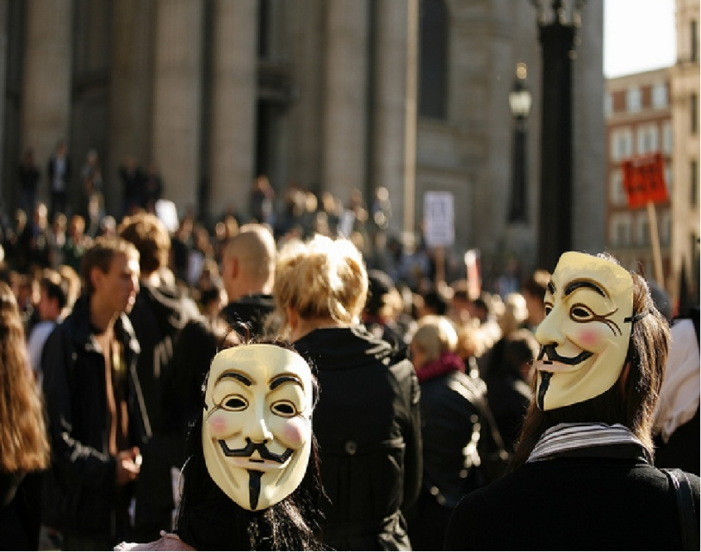
The Guy Fawkes mask.
The Guy Fawkes mask, also known as Anonymus Mask or V, is one of the key symbols of protest and struggle against the current system and reforms in the West. Firstly it appeared in American comic book "V for Vendetta".
This mask was not so popular before the creation of the film. Now the mask is the official symbol of a new subculture Anonymous, which they use during the protests against the Church of Scientology.

Slide 13
Thank you for attention!

